Slide 1
Negative Numbers in Context Worksheet
Mathematics
Mrs Buckmire
Notes:
Pen and paper and encourage to pause

Slide 2
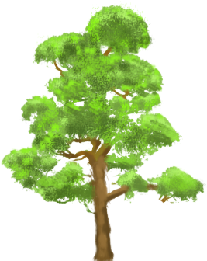
Try this
“You need to go down 1 floor to go from the 2nd floor to the 1st floor”
What other journeys can you describe?
How might you number the red and orange floors?
How might you number the floors on a different building?
2nd Floor
1st Floor
0th Floor
Red floor
Orange floor
Resume the video once completed

Slide 3
Connect
(m)
Here sea level is being used as a point of reference.
B
A
Lake
Sea Level
Sea Level
C
Resume the video once completed
D
Sea

Slide 4
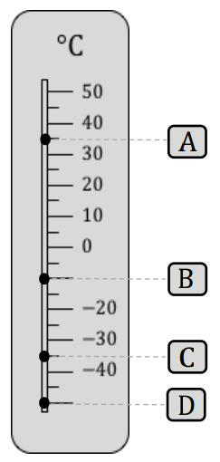
Independent task
Resume the video once completed

Slide 5
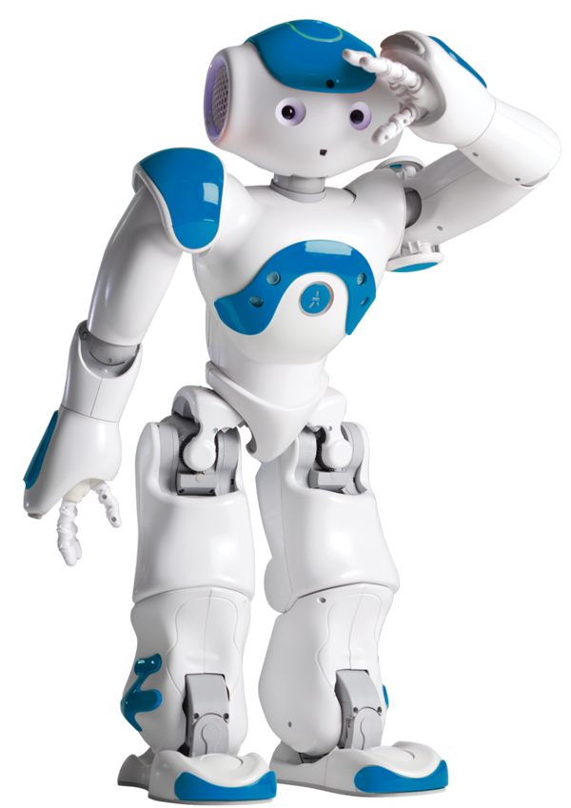
Explore
A robot can be programmed to move East and West
W
E
A
:
< robot.move.east(5)>
B
:
< robot.move.west(3)>
e.g.
A
B
B
A
will send the robot to 4.
Use a combination of As and Bs to send the robot from 0 to the following numbers:
Challenge: Can you find an integer that the robot can’t reach?
Resume the video once completed

