Slide 1
Factorise a quadratic (difference of two squares)
Maths
Mr Clasper

Slide 2
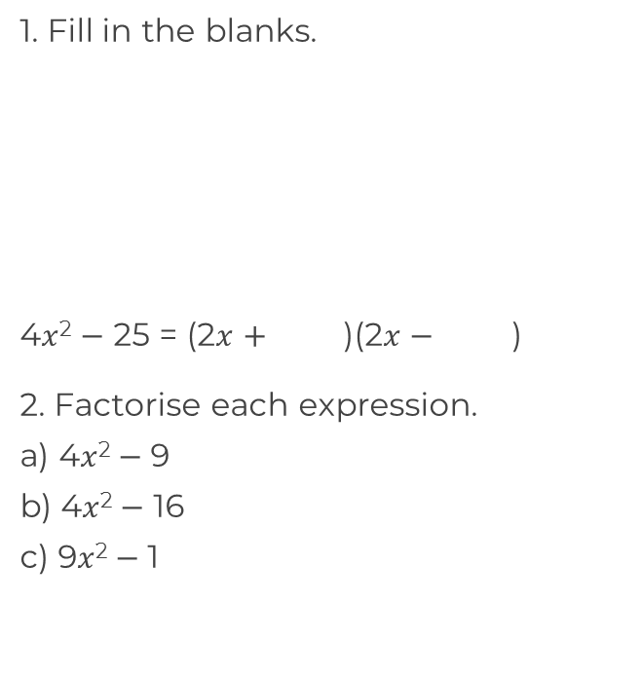
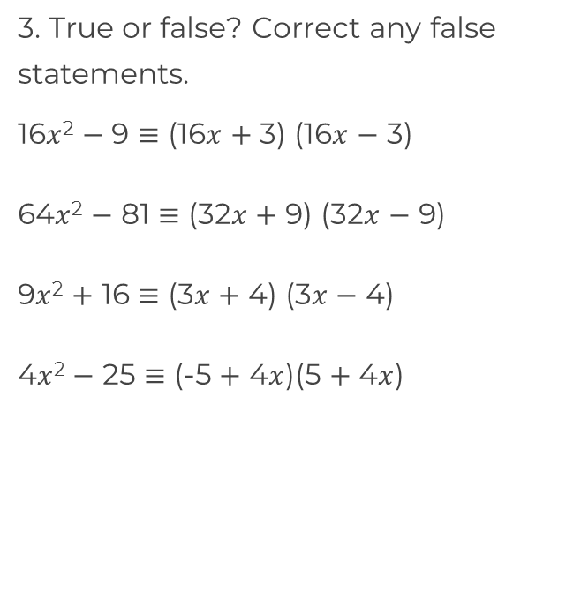
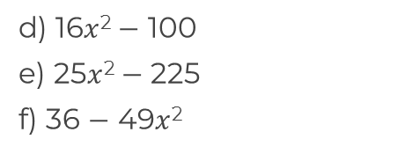
Factorise a quadratic (difference of two squares)
 | -25

Slide 3
Answers

Slide 4
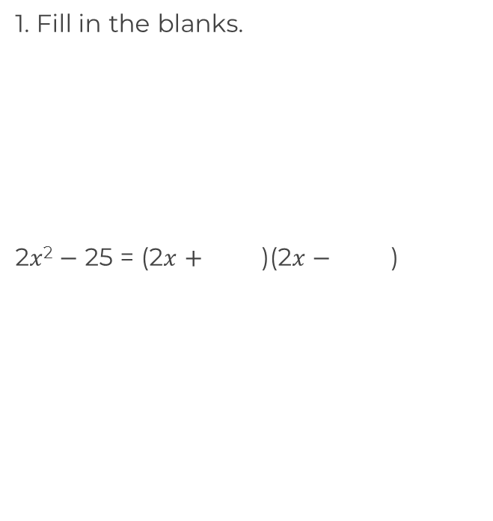
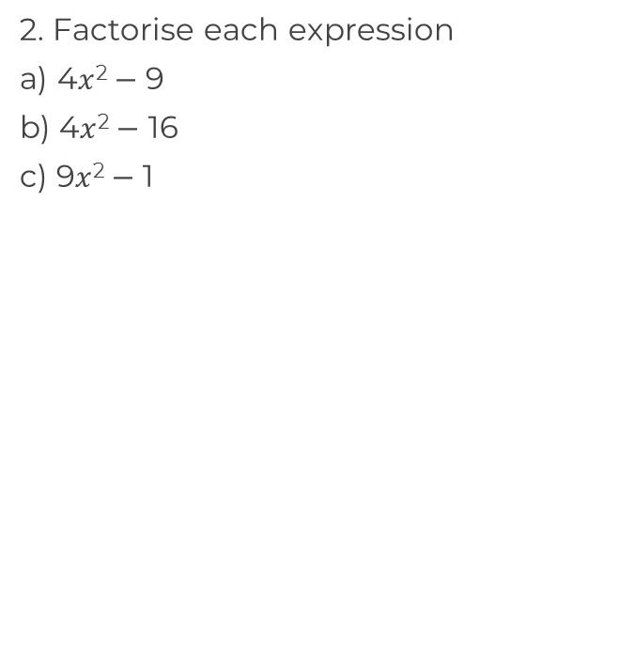
Factorise a quadratic (difference of two squares)
5
 | -25
-5
5
5

Slide 5
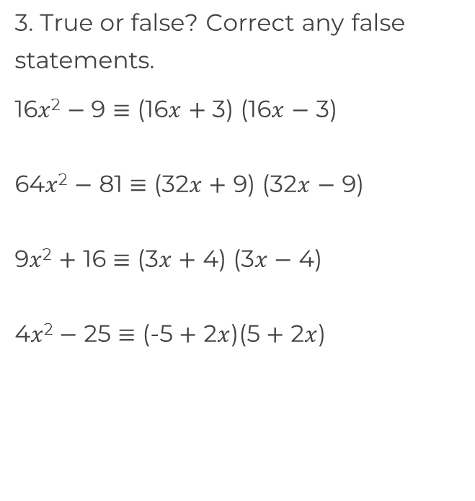
Factorise a quadratic (difference of two squares)
False. Cannot factorise
True

