Slide 1
Composition Following a Recipe: Jam Tarts
Communication and Language: Celebrations – Applying Learning
Alison

Slide 2
For this lesson, you will need:
Paper
Pencil or pen
Ruler
Ingredients and equipment (these will come later)

Slide 3
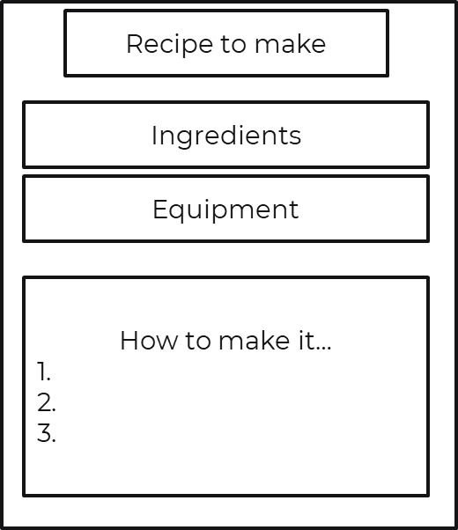
Following a recipe
Create a recipe writing frame using your pencil and ruler.
Draw the boxes, but leave them empty. We will fill them later.

Slide 4
Making the recipe?
Write ‘Jam Tarts’ at the top of your recipe in the title box.
Add the ingredients into the correct space. You can write, draw or stick the symbols if you have them at home.
Try to find what you need independently.

Slide 5
Now it’s time to complete the activity
Making Jam Tarts
Prepare the writing frame and add the title and ingredients.
Try to find what you need independently by matching the symbols with the product.

Slide 6
Making Jam Tarts
Add the equipment you will need into the correct space. You can write, draw or stick the symbols if you have them at home.
Try to find what you need independently.
Note: Adult support is required when using a hot oven and always wear oven gloves.

Slide 7
Now it’s time to complete the activity
Making Jam Tarts
Add the equipment to your writing frame.
Try to find what you need independently by matching the symbols with the resource.

Slide 8
Making Jam Tarts
Now that you have all of your ingredients and equipment ready, we can start ordering the recipe.
After you have read every step, record this on your writing frame.
There are 6 steps in this recipe.
by

Slide 9
Making Jam Tarts Step 1
Turn the oven on to 180°C or gas mark 5
Note: Remember that the oven is hot and adult support is needed
by matching the symbols with the
y to find what you need independently by matching the symbols with the product.

Slide 10
Making Jam Tarts Step 2
Put 250g plain flour into a bowl
Add 125g butter
Rub together with your fingers
by matching the symbols with ou

Slide 11
Making Jam Tarts Step 3
Add a splash of water and mix into a dough
by matching the symbols with the
y to find what you need independently by matching the symbols with the product.

Slide 12
Making Jam Tarts Step 4
Roll out the dough
Cut out circles
Put into tart tin
Note: Remember that an adult should be present for support
by matching the symbols with the
y to find what you need independently by matching the symbols with the product.

Slide 13
Making jam tarts Step 5
Fill each pastry case with jam

Slide 14
Making Jam Tarts Step 6
Bake in the oven for 15 mins
by matching the symbols with the
Note: Remember that the oven is hot and adult support is needed i what you need independently by matching the symbols with the product.

Slide 15
Now it’s time to complete the activity
Making Jam Tarts
Add the recipe to your writing frame.
Follow your instructions and make your jam tarts.
Share them with your family.

Slide 16
Make it easier
Make it harder
More ideas
Use symbols to support the learner.
Adult leads the making and the learner copies. Demonstrate by saying ‘my turn, your turn’.
See if the learner can remember what comes next in the recipe.
Ask the learner what equipment they need at different times.
Find different recipes. Use a writing frame to create your recipe then work with your family to make the food.

