Slide 1
Electrolysis Review
Combined Science - Chemistry - Key Stage 4
Mr Campbell

Slide 2
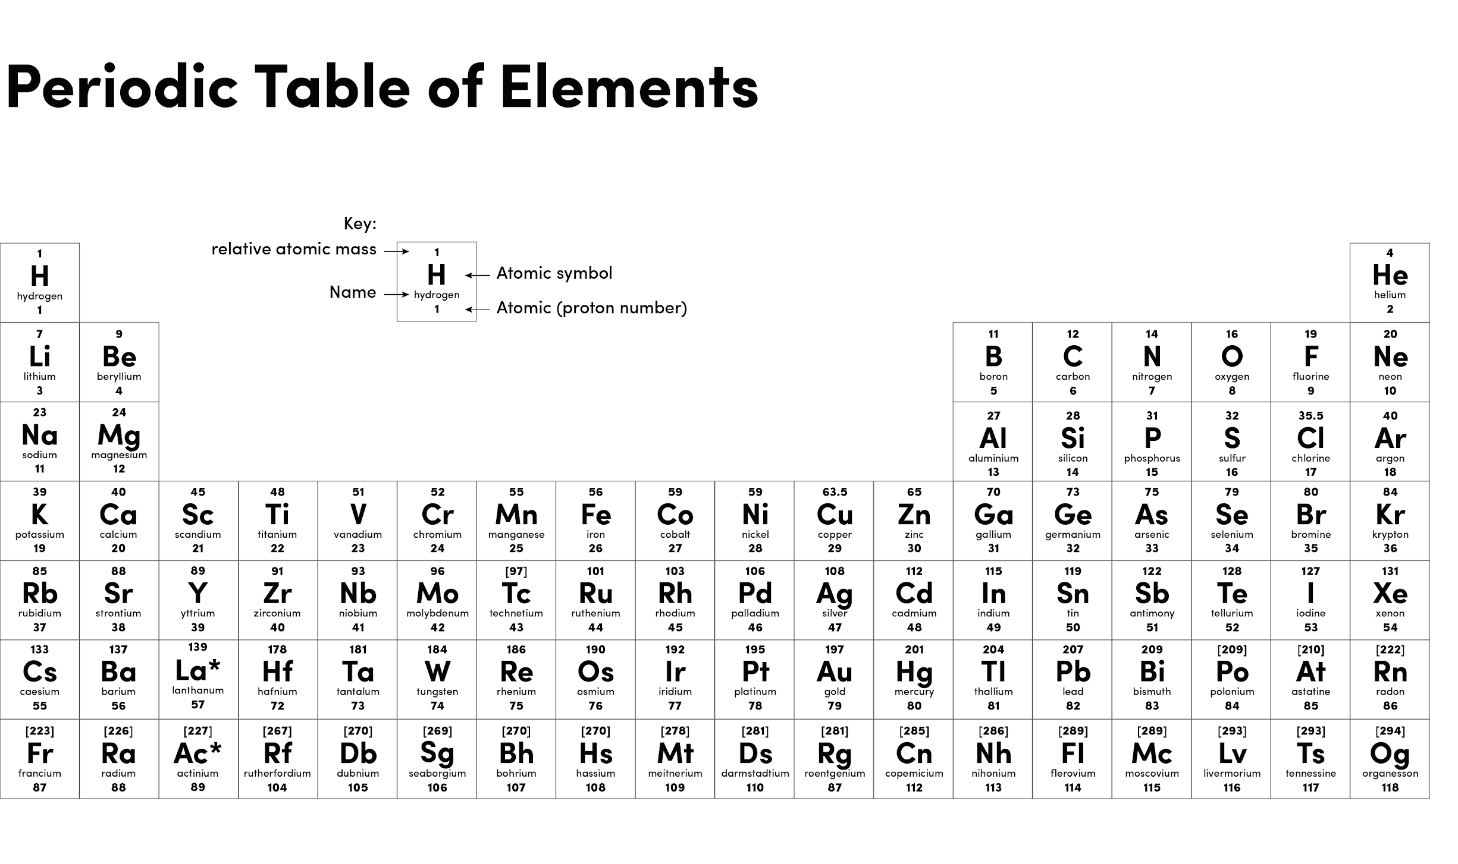
Source: Oak

Slide 3
Knowledge quiz
What is electrolysis?
What is the charge on the cathode?
Why does the ionic compound being electrolysed need to be molten or dissolved?
Why does aluminium need to be extracted from aluminium oxide using electrolysis?
Why is cryolite used during the electrolysis of aluminium oxide?
Why does the anode need periodically replacing during the electrolysis of aluminium oxide?
What is the name of the positive electrode in electrolysis?
What would form at the anode and cathode during the electrolysis of molten sodium chloride?
During the electrolysis of sodium chloride solution hydrogen forms at the cathode, explain why.
What will form at the anode during the electrolysis of of copper sulfate solution?

Slide 4
Knowledge quiz - Answers
What is electrolysis? The breaking down of ionic compounds using electricity
What is the charge on the cathode? Negative
Why does the ionic compound being electrolysed need to be molten or dissolved?
So the ions are free to move
4. Why does aluminium need to be extracted from aluminium oxide using electrolysis?
Aluminium is more reactive than carbon, so carbon can not remove the oxygen from aluminium oxide.
5. Why is cryolite used during the electrolysis of aluminium oxide? Cryolite lowers the melting point of the aluminium oxide, reducing energy costs.

Slide 5
Knowledge quiz - Answers
6. Why does the anode need periodically replacing during the electrolysis of aluminium oxide? Oxygen produced at the anode reacts with the carbon anode forming carbon dioxide, this wears away the anode.
7. What is the name of the positive electrode in electrolysis? Anode
8. What would form at the anode and cathode during the electrolysis of molten sodium chloride? Anode = chlorine Cathode = Sodium
9. During the electrolysis of sodium chloride solution hydrogen forms at the cathode, explain why. Sodium is more reactive than hydrogen.
10. What will form at the anode during the electrolysis of of copper sulfate solution? Oxygen

Slide 6
 | Extraction of iron from iron oxide | Extraction of aluminium from aluminium oxide
Obtaining the ore | Mined from earth's crust | Mined from earth's crust
Method of extraction | Heating with carbon | Electrolysis
Cost of extraction per tonne (£) | 500 | 1500
Energy needs of extraction per tonne (KJ) | 750 | 1000
Solid waste produced per tonne of metal extracted (tonnes) | 800 | 200
Compare the extraction of iron and aluminium from their ore.
Similarities
Differences
Use comparative language
Use data to illustrate

Slide 7
Similarities
Both ores are mined from the earth’s crust
Differences
Iron is extracted from its ore by heating with carbon whereas electrolysis is used for aluminium
It costs more to extracted aluminium from its ore, three times more or £1000 per tonne more.
The energy needs are higher to extract aluminium from its ore, 1.5 times more or 375 KJ per tonne more
More solid waste is produced during the extraction of iron, 4 times more or 600 tonnes more.

Slide 8
 | Extraction of iron from iron oxide | Extraction of aluminium from aluminium oxide
Obtaining the ore | Mined from earth's crust | Mined from earth's crust
Method of extraction | Heating with carbon | Electrolysis
Cost of extraction per tonne (£) | 500 | 1500
Energy needs of extraction per tonne (KJ) | 750 | 1000
Solid waste produced per tonne of metal extracted (tonnes) | 800 | 200
Evaluate the two methods of extraction of metals from their ore. Use data from the table and your own knowledge.
Positives and Negatives
Overall opinion
Add value to the information do not just repeat it!

Slide 9
Iron/heating with carbon
Positives
The energy needs and costs are lower, x1.5 and x3 lower, so it is cheaper
Negatives
The ore is mined from the earth’s crust this will destroy habitats and create noise/dust pollution.
A larger amount, x 4, of solid waste is produced which will need to be disposed of and take up space in landfill, which affects habitats

Slide 10
Aluminium/Electrolysis
Positives
Produces less solid waste so less waste going to landfill
Negatives
Aluminium needs electrolysis for extraction due to being more reactive than carbon.
The energy needs and costs are much higher due to the electricity needed for electrolysis.
The ore is mined from the earth’s crust this will destroy habitats and created noise/dust pollution.

Slide 11
Overall opinion - Heating with carbon is the best option for extracting a metal from its ore as it is cheaper and has lower energy needs, however, this method can only be used if the metal is less reactive than carbon.

