Slide 1
Express future intentions [2/2]
-Using the structure aller + infinitive
-Using ne….pas
French
Madame Johnson

Slide 2
[ ou ]
nous

Slide 3
[ ou ]
trouver
toujours
jouer
[always; still]

Slide 4
en retard | late
devenir | to become
partir | to leave
revenir | to come back
à l’avenir | in the future
l’avenir | the future
sortir | to go out

Slide 5
Reminder:
Making a sentence negative in French
ne
pas
Je parle
Add ne and pas before and after the verb
Je parle

Slide 6
Making a sentence negative in French
Je écoute
ne
pas
Je écoute
J’écoute
n’
pas
Je écoute
ne changes to n’ before a verb starting with a vowel.

Slide 7
Aller with ne….pas
Je vais
Je ne vais pas
[I am going]
[I am not going]

Slide 8
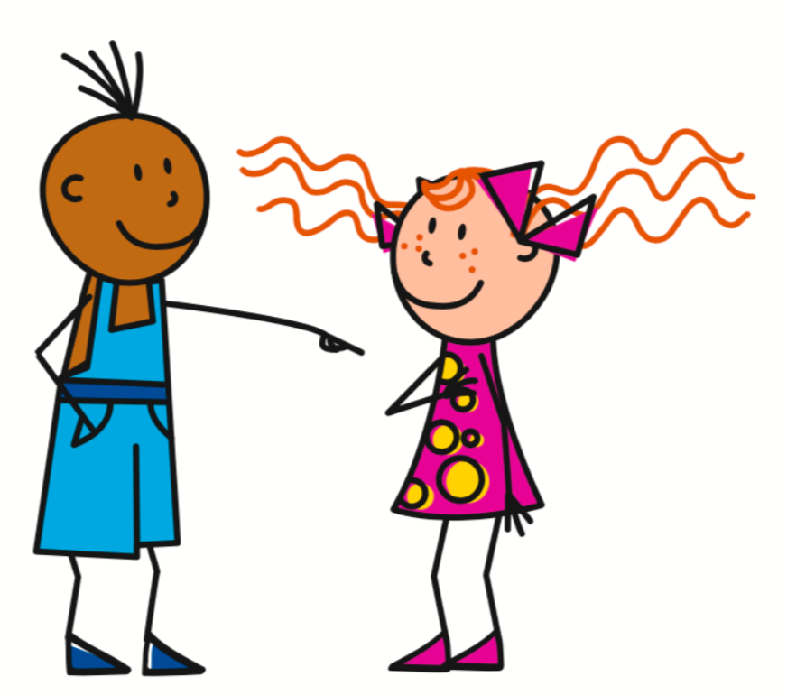
Aller with ne….pas
Tu vas
Tu ne vas pas
[You are going]
[You are not going]

Slide 9
Aller with ne….pas
Il va
Il ne va pas
[He is going]
[He is not going]
Elle va
Elle ne va pas
[She is going]
[She is not going]

Slide 10
Aller with ne….pas
Nous allons
Nous n’allons pas
[We are going]
[We are not going]
Vous allez
Vous n’allez pas
[You are going]
[You are not going]

Slide 11
Aller with ne….pas
Ils vont
Ils ne vont pas
[They are going]
[They are not going]
Elles vont
Elles ne vont pas
[They (f.) are going]
[They are not going]

Slide 12
Expressing future intentions with ne...pas
Use the present tense form of aller (with ne...pas), followed by the infinitive.
Je ne vais pas
manger
[I am not going]
[to eat]

Slide 13
Expressing future intentions
Use the present tense form of aller (with ne...pas), followed by the infinitive.
Tu ne vas pas
manger
[You are not going]
[to eat]

Slide 14
Expressing future intentions
Use the present tense form of aller (with ne...pas), followed by the infinitive.
Il ne va pas
faire
[He is not going]
[to do]
Elle ne va pas
sortir
[She is not going]
[to go out]

Slide 15
Expressing future intentions
Use the present tense form of aller, followed by the infinitive.
Nous n’allons pas
jouer
[We are not going]
[to play]
Vous n’allez pas
sortir
[You are not going]
[to go out]

Slide 16
Expressing future intentions
Use the present tense form of aller (with ne...pas), followed by the infinitive.
Ils ne vont pas
faire
[They are not going]
[to do]
Elles ne vont pas
sortir
[They (f.) are not going]
[to go out]

Slide 17
Express future intention [2 / 2]
I am going to play = Je vais jouer
I am not going to play = Je ne vais pas jouer
We are going to watch = Nous allons regarder
We are not going to watch = Nous n’allons pas regarder
She is going to leave = Elle va partir
She is not going to leave = Elle ne va pas partir
5
4
3
2
1

