Slide 1
Moments and Levers
Physics - Key Stage 4 - Forces
Mr Saville
Miss Whittick

Slide 2
Independent Practice - You Do
A force of 60 N is applied to a door, 0.4 m from the pivot. Calculate the moment of the force
A force of 623 N is applied to a car wheel that is 0.3 m from the pivot. Calculate the moment of the force. Give your answer to 3 significant numbers.
A crane applies a 7 kN force on a load that is 50m from the pivot. Calculate the moment of the force.
A boy with a weight of 700 N sits on a seesaw 120 cm away from the pivot. Calculate the moment of the force.
A force of 1.2 kN is applied on a load that is 234 cm away from the pivot. Calculate the moment of the force.

Slide 3
Independent Practice - Answers
A crane carries a load of 1000 N and creates a moment of 12000 Nm. Calculate the perpendicular distance of the load from the pivot.
A fork-lift truck with a load of 3 kN causes a moment of 6000 Nm. Calculate the distance from the pivot.
A spanner tightens a bolt with a moment of 240 Nm. Calculate the force needed to loosen the bolt when you hold the spanner 40 cm away from the pivot.

Slide 4
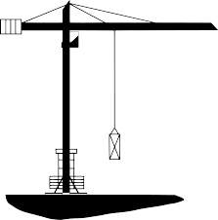
You do: Is this crane balanced?
Weight = 300 N
1 m
4 m
Weight = 100 N
Clockwise Moment = Anticlockwise Moment
Credit: no attribution required

