Slide 1
Subtracting two digit numbers involving regrouping
Mathematics
Lesson 7 of 10
Ms. Dobrowolski

Slide 2
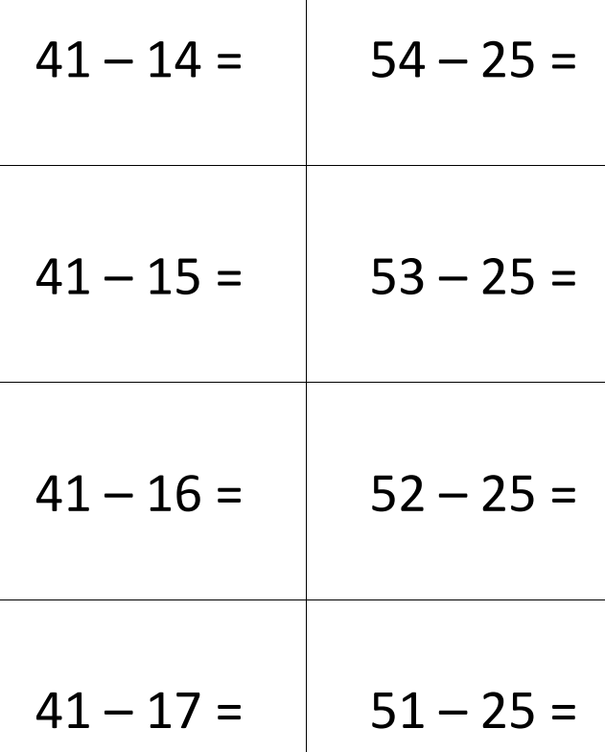
Independent Task
Use the whole part model and the Make 10 strategy to solve the following equations

