Slide 1
Inverse proportion in context
Downloadable resource
Mathematics
Dr Rim Saada

Slide 2
Cala fills a fish tank.
She has a range of jugs she can use to carry water to the fish tank.
If Cala uses a 4 litre jug, she will need to use 15 jugfuls.
How many jugfuls are needed if she uses a 6 litre jug?

Slide 3
Oliver from the Steel Construction Company can build a house by himself in 48 days. If Oliver and Jane work together to build a house of the same size, how long will it take to build the house?
2) It takes 6 hours to fill a pool with water coming from three taps. How long would it take if only two taps are switched on?
3) It usually takes Harry around 7 hours to write two chapters of a novel. How many chapters should he expect to write in 24.5 hours?

Slide 4
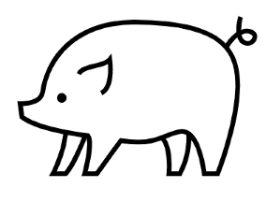
A farmer is building a rectangular pen for his pigs.
The length and width are denoted by 𝑙 and 𝑤.
The area must be 100 m².
Explain how you know that 𝑙 and 𝑤 are inversely proportional.
Notes:
Choose any two and explain how they represent the same maths

