Slide 1
Substitute the exact values to find a missing length
Maths
Mrs Dennett

Slide 2
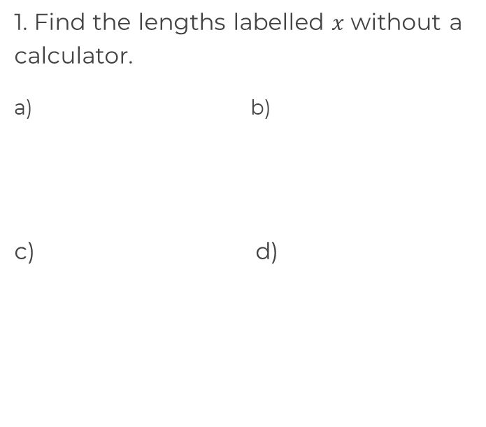
Substitute the exact values to find a missing length
30 mm
15 cm
14 cm
45°
30°
30°
4.2 cm
60°
x cm
2 cm
30°
30°

Slide 3
Answers

Slide 4
Substitute the exact values to find a missing length
30 mm
15 cm
14 cm
45°
30°
7.5 cm
30 mm
30°
4.2 cm
60°
x cm
2 cm
30°
30°
8.4 cm

