Slide 1
French
Assessment
Year 7 French
Term 3 - Applying your knowledge test
Resources by NCELP/University of York. Content has had superficial branding changes from NCELP/University of York (CC BY-NC-SA)

Slide 2
Achievement Test - Year 7 Term 3 French
Your name: ______________________ Your class / name of teacher: ______________________
The test is in four sections:
Section A: Listening (5 minutes)
Section B: Reading (10 minutes)
Section C: Writing (15 minutes)
Section D: Speaking (6 minutes)
This makes a total of 36 minutes to complete the entire test.
Remember – always just have a go! If you know some words, just write or say them!
Just do what you can!

Slide 3
SECTION A: Listening
On the next slide, you will hear a short story about Amir and Noura’s day.
Tick the box under the person or people that the statement is about.
You will hear the story twice. There will be a 20 second pause in between.
After hearing it twice, you have another minute to finish the grid.

Slide 4
Who? | Noura | Amir | Noura and Amir | The story doesn't say
1. is going to school | ☐ | ☐ | ☐ | ☐
2. is ill | ☐ | ☐ | ☐ | ☐
3. is pleased | ☐ | ☐ | ☐ | ☐
4. likes staying at home | ☐ | ☐ | ☐ | ☐
5. likes writing | ☐ | ☐ | ☐ | ☐
6. normally plays with friends | ☐ | ☐ | ☐ | ☐
7. likes walking in the park | ☐ | ☐ | ☐ | ☐
8. finds the situation difficult | ☐ | ☐ | ☐ | ☐
9. is listening to a story | ☐ | ☐ | ☐ | ☐
10. is calm | ☐ | ☐ | ☐ | ☐

Slide 5
SECTION B: Reading Léa is texting Sophie about holiday plans. Translate what she says into English.
Write your answer in English. You have 10 minutes to complete this part of the test.
Que fais-tu aujourd’hui, Sophie?________________________________________________________________
Je travaille en ce moment. _____________________________________________________________________
Mais souvent je vais chez Amir. _________________________________________________________________
Il habite à Nice! ________________________________________________________________________________
C’est une ville très intéressante._________________________________________________________________
Parfois, nous allons à la plage et nous faisons une promenade en bateau! ________________________________________________________________________________________________
Où vas-tu normalement en vacances ?________________________________________________________

Slide 6
SECTION C: Writing Read the message below from Amir. Translate what he says into French..
Write your answer in French. You have 15 minutes to complete this part of the test.
Hello, it’s Amir! _________________________________________________________________________________
I have a sister, Noura. __________________________________________________________________________
She is a nice and very intelligent girl! ___________________________________________________________
We like watching films at the cinema __________________________________________________________
I don’t have a brother.__________________________________________________________________________
Do you have a brother? ________________________________________________________________________
I’m learning English. ___________________________________________________________________________
What language are you learning? ______________________________________________________________
Do you know how to speak French? __________________________________________________________

Slide 7
SECTION D: Speaking
You will need to record your speaking. Your teacher may have given you instructions already. If not, use the instructions below:
Before you start this section of the test, please go to this website: vocaroo.com. It will open in a new tab. Click the red record button, then come back to this test.
Take up to one minute to think about what to say each time, but don’t write your sentences down.
It doesn’t matter if you make a mistake - just have a go! It doesn’t matter if you speak slowly - just keep going!

Slide 8
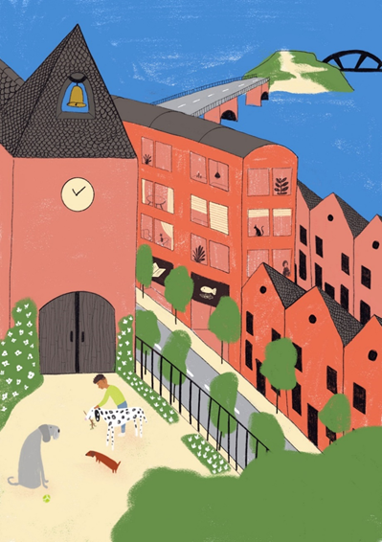
Look at the picture on the left.
Describe it to a friend by saying these sentences in French:
1. Amir is wearing a green shirt.
2. It is nice weather in England today.
3. Three dogs are playing in the park.
4. There is an island and there are two bridges, but there is no café.
5. The church is in front of the big buildings.
To help you work out what to say, try to break each sentence into groups of words.

Slide 9
Now go back to the Vocaroo window.
Click on the red button. Click on "Save & Share".
Copy & paste / write the URL for your Vocaroo recording here:
END OF ASSESSMENT

