Slide 1
Using direct proportion graphs
Maths
Mr Clasper

Slide 2
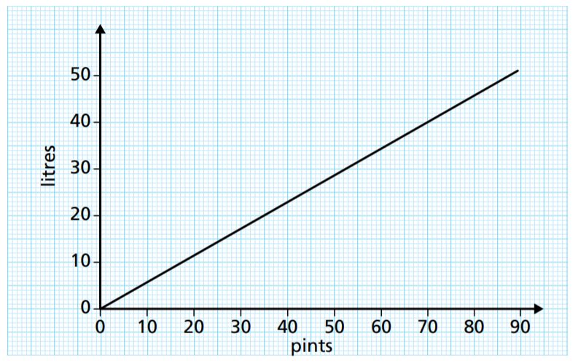
Using direct proportion graphs
1. This conversion graphs can be used to convert between pints and litres.
Use the graph to convert
a) 60 pints into litres
b) 10 litres into pints
c) 1000 litres into pints
2. Table shows the pounds you get for different values of euros.
a) Draw a graph to represent this.
b) Explain how you know the currencies are in direct proportion.
Pounds | 10 | 20 | 40 | 80 | 100
Euros | 11 | 22 | 44 | 88 | 110
‹#›

Slide 3
Using direct proportion graphs
3. Decide whether each graph shows a direct proportion relationship.
a) b) c)
d) e) f)
O
O
O
O
O
O
‹#›

Slide 4
Answers

Slide 5
Using direct proportion graphs
1. This conversion graphs can be used to convert between pints and litres.
Use the graph to convert
a) 60 pints into litres
b) 10 litres into pints
c) 1000 litres into pints
2. Table shows the pounds you get for different values of euros.
a) Draw a graph to represent this.
b) Explain how you know the currencies are in direct proportion.
Pounds | 10 | 20 | 40 | 80 | 100
Euros | 11 | 22 | 44 | 88 | 110
100
x
Pounds
x
80
60
40
x
34 litres
20
x
x
0
0
20
40
60
80
100
120
Euros
18 pints
1800 pints
Graph is a straight line that passes through origin
‹#›

Slide 6
Using direct proportion graphs
3. Decide whether each graph shows a direct proportion relationship.
a) b) c)
d) e) f)
No
No
Yes
O
O
O
Yes
No
No
O
O
O
‹#›

