Slide 1
Inequalities and the Cartesian plane
Downloadable Resource
Mathematics
Mr Maseko

Slide 2
Try this
( , )
Fill in the blanks to make a coordinate with the following rules
The x-ordinate must be greater than 2 and less than less
The y-ordinate must be greater than -3 and less than 3

Slide 3
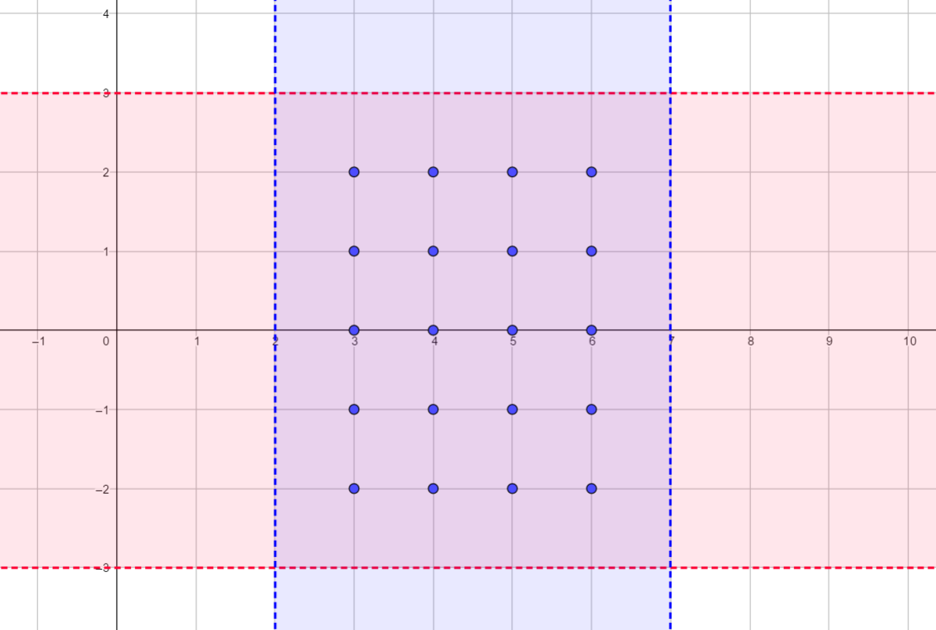
Connect
We can draw horizontal and vertical lines on a coordinate grid to show the boundaries we have been set
Notes:
Revisit inequality notation and how this relates to the diagram. Note that this diagram refers to the Do Now and is used again in the Explore.

Slide 4
Connect
Writing as inequalities
Notes:
Revisit inequality notation and how this relates to the diagram. Note that this diagram refers to the Do Now and is used again in the Explore.

Slide 5
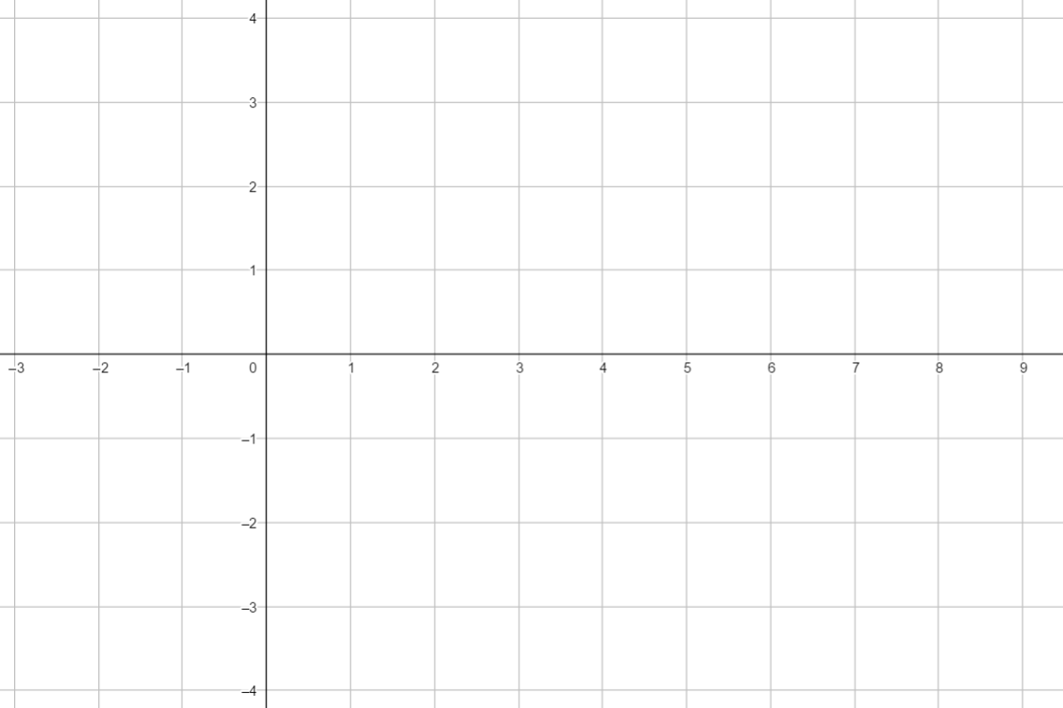
Independent task
Write the inequality -5 < x < 3 in words.
On the grid, show all the coordinates that satisfy the following inequalities
-2 < x < 3
-2 < y < 2

Slide 6
Explore
Find another pair of inequalities that can be satisfied with exactly 20 integer coordinates.
This diagram shows there are 20 coordinates with integer values within the following inequalities
2 < x < 7
-3 < y < 3
Notes:
SUPPORT
Consider if the one of the inequalities changed
SUPPORT 2
3<𝑥< ?
−3<𝑦<3

