Slide 1
Comparing and ordering numbers within 50
Mathematics
Mrs Bramble and Miss Sidhu

Slide 2
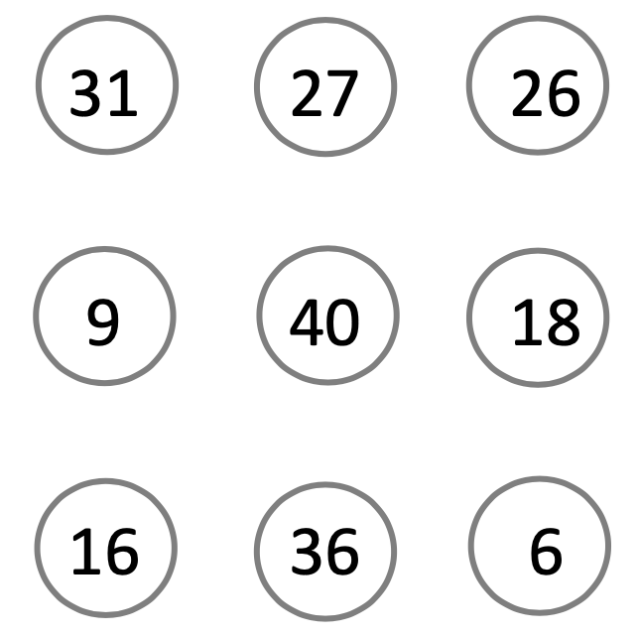
Independent Task
Order the numbers from the least to the greatest value.

Slide 3
Challenge
Order the numbers from the greatest to the least value.
24
18
39

Slide 4
Support

