Slide 1
Lesson 5: Comparing Data Visually
Flat-File Databases
Computing
Andy Bush
Materials from the Teach Computing Curriculum created by the National Centre for Computing Education

Slide 2
Task 1 - Which Graph?
Which chart answers the question best and why?

Slide 3
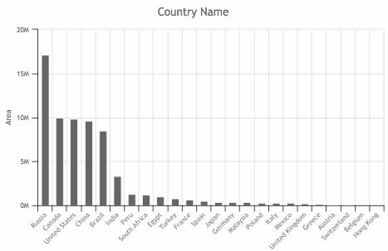
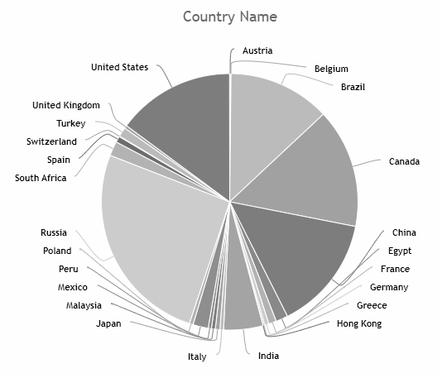
Task 1 - Which Graph?
Which country has the largest area?
Chart 1
Chart 2

Slide 4
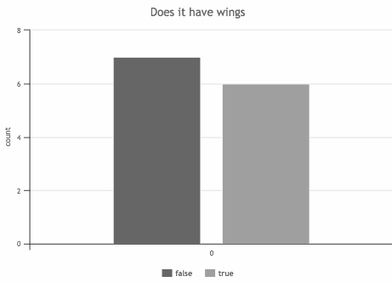
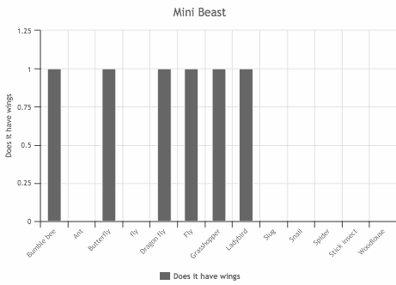
Task 1 - Which Graph?
Which minibeasts have wings?
Chart 1
Chart 2

Slide 5
Task 2 - Creating Charts to Answer Questions
Open oaknat.uk/comp-dat54-2 (Titanic Database)
Use the chart tool to answer the questions on the next page.
Think carefully about the following:
Which chart type have you chosen?
Which fields did you choose for the x and y axes?
Why did you decide that type of chart was the most appropriate?

Slide 6
Task 2 - Creating Charts to Answer Questions
Were there more males or females on board the Titanic?
Who was the oldest passenger on board the Titanic?
How many males were in First class?
How many people boarded at Belfast or Queenstown?
For each of the above note down:
The answer
The chart type have you choose?
The x and y axes fields (if used)
The reason you chose that chart type.

