Slide 1
Finding solutions to problems with two variables
Independent Task
Mathematics
Miss Jones

Slide 2
Question 1
2x + y = 7 and x + y = 5
What are the values of x and y?

Slide 3
Question 2
a + 1 = 2b +3
'a' and 'b 'are positive 1-digit integers.
Record a correct pair of values for 'a' and 'b'.

Slide 4
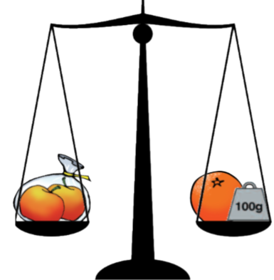
Question 3
Assume that both apples have the same mass.
The mass of the orange is 30g greater than one apple.
What is the mass of one apple?
What is the mass of the orange

Slide 5
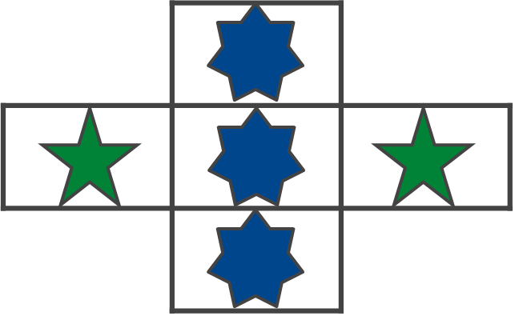
Question 4
What is the value of each shape?
Total
100
Total
102

