Slide 1
Mathematics
Prime Factorisation
Downloadable Resource
Mr Langton

Slide 2
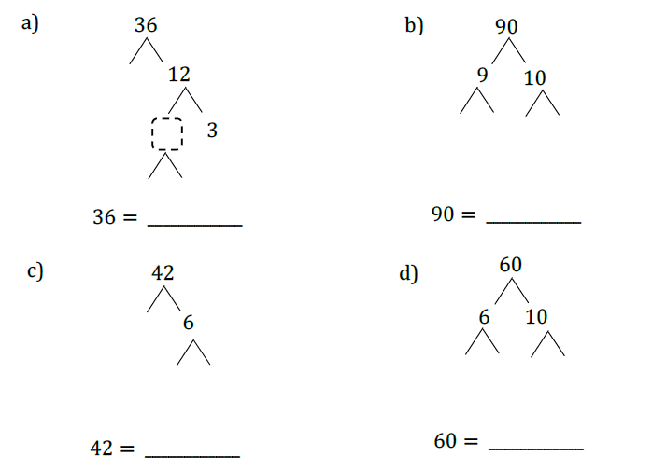
Prime Factorisation
1. Complete the prime factorisation trees and write the numbers as products of prime factors.
2. Write each of these numbers as products of prime factors.
a) 72 b) 24 x 10
c) 175 d) 50²
3. “a” is half the size of “b”.
True or false?

