Slide 1
In the same ratio Lesson 2 of 8
Mathematics
Miss Kidd-Rossiter

Slide 2
Here are some students’ colouring patterns for the grid in the centre.
I’m going to use 2 red tiles and 4 blue tiles in each row
I’m going to use 10 red tiles and the rest will be blue
Yasmin
Cala
I’m going to use red tiles and blue tiles in the ratio 1 : 4
I’m going to use 20 more blue tiles than red tiles altogether
Antoni
Xavier
How many tiles of each colour does each student use?

Slide 3
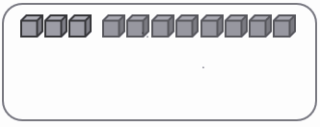
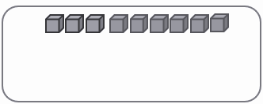
Red cubes:
Blue cubes:
The ratio of red cubes to blue cubes is ___ : ___
If 2 cubes of each colour cubes are taken away, the ratio of red cubes to blue is ___ : ___
If 2 red and 4 blue cubes are taken away, the ratio of red cubes to blue cubes is ___ : ___
* For this diagram, the first three cubes are red and the last 8 are blue
* For this diagram, the first three cubes are red and the last 6 are blue

Slide 4
This paint is mixed to make orange.
Which of these will make the same shade of orange?
2 litres red, 3 litres yellow.
5 litres red, 8 litres orange.
6 litres red, 15 litres yellow.
20 cl red, 50 cl yellow.
2 litres red
5 litres yellow

Slide 5
I mix 12 litres of yellow paint and 6 litres of blue paint to make green.
I need more of the same colour.
I have 8 litres more yellow.
How much more blue paint should I use?

Slide 6
Pink paint is made with red and white in the ratio 4 : 3. Copy and complete the table so that each line makes the same colour of pink.
Red | White | Total
8 litres
 | 15 litres
10 litres
 |  | 28 litres

Slide 7
Some students are designing a pattern for a mural.
First, they make part of the pattern.
In this ‘block’ they use green tiles : orange tiles in the ratio 13 : 7.
This ‘block’ is repeated lots of times to make the whole pattern.
40cm
How many green tiles will be needed to repeat this pattern if the mural:
measures 80cm by 40cm?
measures 4m by 6m?
has an area of 4000cm²?
20cm

Slide 8
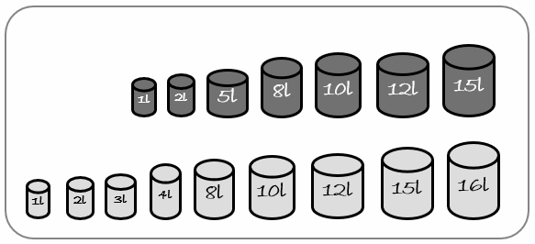
Beth mixes a pot red paint and a pot of yellow paint to make orange paint. She then mixes another pot of red paint and a pot of yellow paint and makes the same shade.
What size pots could Beth have picked?
What about if she can use multiple pots?
Red paint:
Yellow paint:

