Slide 1
Independent Living Unit 1 - Home Management
Oak Specialist
Building Understanding

Slide 2
Unit 1- Home Management
Lesson 1- Cleaning in the home
Lesson 2- Setting the table
Recognising common cleaning equipment and where to use it.
Counting equipment needed and using a visual to set the table.
Lesson 3- Sorting in the kitchen
Lesson 4- Organising clothes
Recognising kitchen appliances and what we use them for.
Sorting clothes by category and folding correctly.
Lesson 5- Clothes for occasions
Lesson 6- Using a washing machine
Identifying different items of clothing dependent on the occasion or weather.
Following step by step instructions to use a washing machine.
‹#›
Notes:
Depending on how many lessons for each unit, there could be a 2nd page for lesson 5…etc

Slide 3
Lesson 1 - Cleaning in the home

Slide 4
Teacher notes - Cleaning in the home
Learning Intention: To label cleaning items and equipment and match them to the correct cleaning job
Introduce each item. It is best to show the real item. Ask if learner can name them or match to a symbol grid showing common household objects.
What is each item used for?
Where can you use the items and equipment?
Resources needed: sponge, vacuum, washing liquid, washing spray, brush, mop and cloth
Notes:
This is the equivalent to a loose lesson plan/overview for teachers before starting the lesson.

Slide 5
Safety notice
This lesson involves cleaning products which may be harmful to you or the learner if used incorrectly. Please follow the safety guidelines on the products and ensure adult supervision when handling these products.

Slide 6
Cleaning in the home
Home Management
Building Understanding
Notes:
Lesson 1 starting screen. Repeat for each lesson

Slide 7
Lesson activity stages
Introduce cleaning items and products
What are they used for?
Where can we use them?
How do we use them?
Notes:
Lesson 1 breakdown of the lesson. Repeat for each lesson.

Slide 8
What can you see?

Slide 9
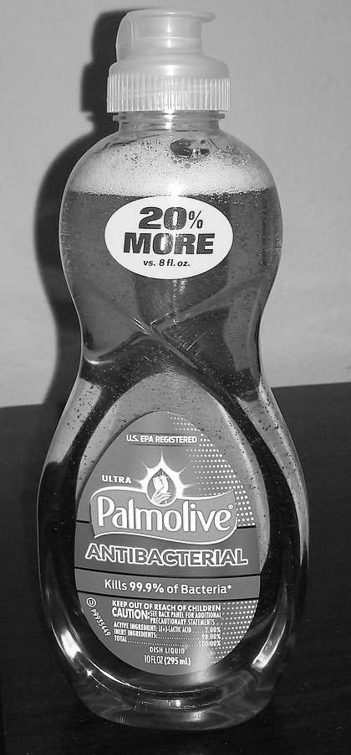
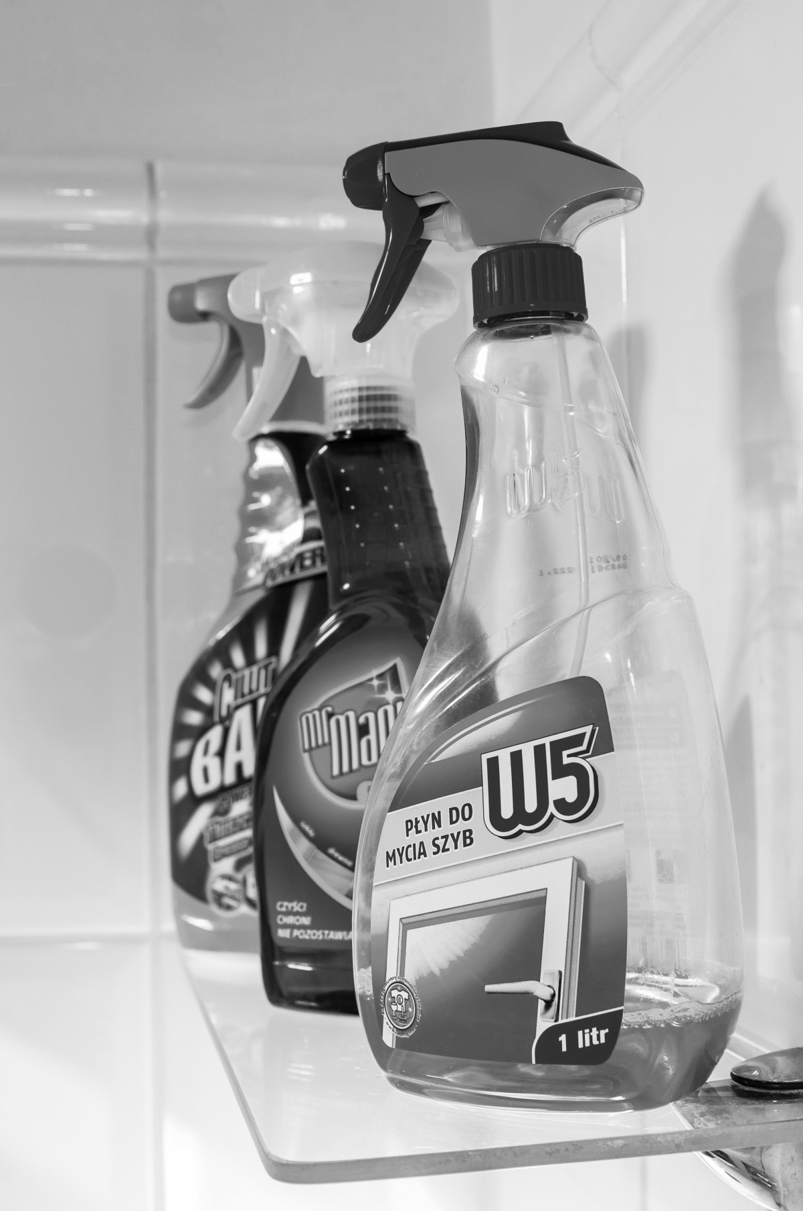
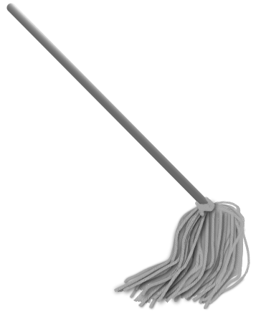
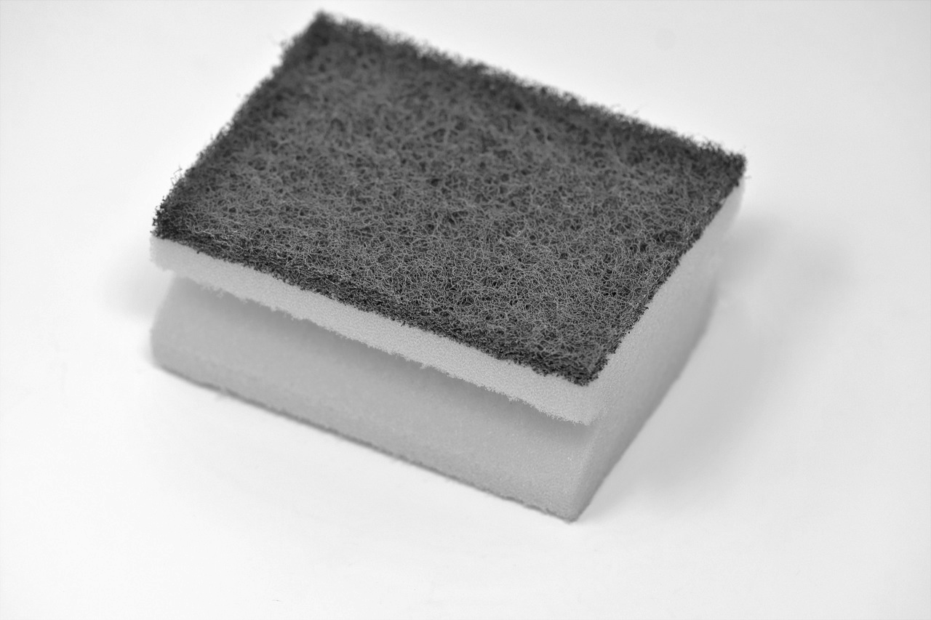
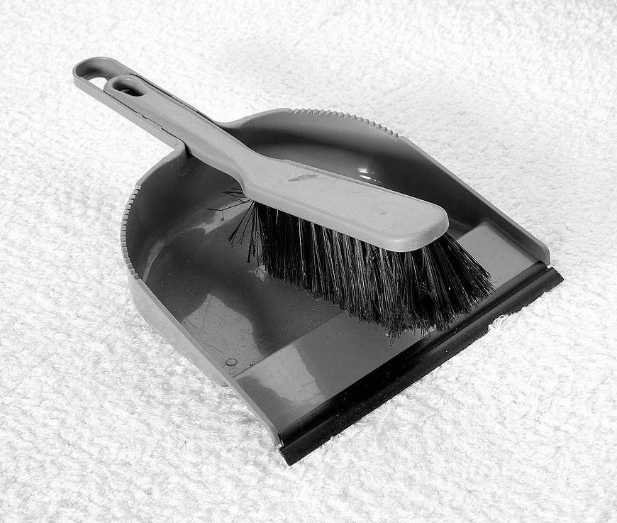
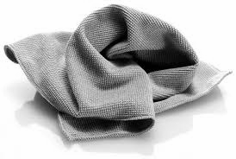
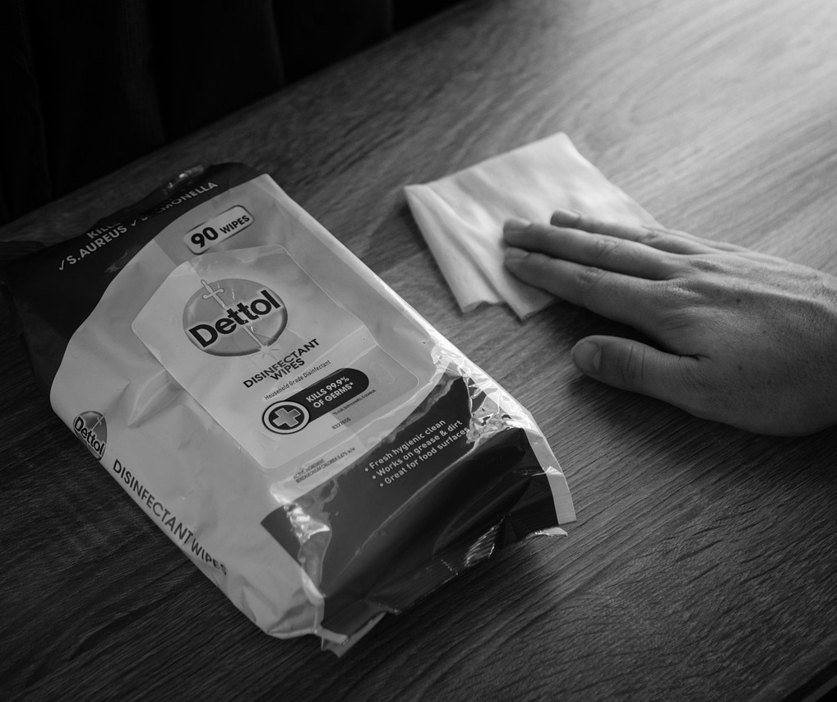
Cleaning your home
With an adult, collect all the items shown in the grid above. Can you match the real item with the image in the grid?
Notes:
Collect all the items show in the grid above. Show or print this grid for your learner. Introduce each of the real items and see if your learner can match the real item to the image in the grid. Verbally label each item.

Slide 10
What do you use these items for?
cleaning
sweeping
washing
Notes:
Group washing up liquid and sponge together. Hold up products and items and check for understanding of what each item is for. E.g. what is the dustpan and brush for? It’s for sweeping. What is the sponge and washing up liquid for? It’s for washing etc.

Slide 11
Where can you use these items?
Notes:
Use the following slides to check understanding of where you can use each of the products. You could hold the real items up first when asking the questions.

Slide 12
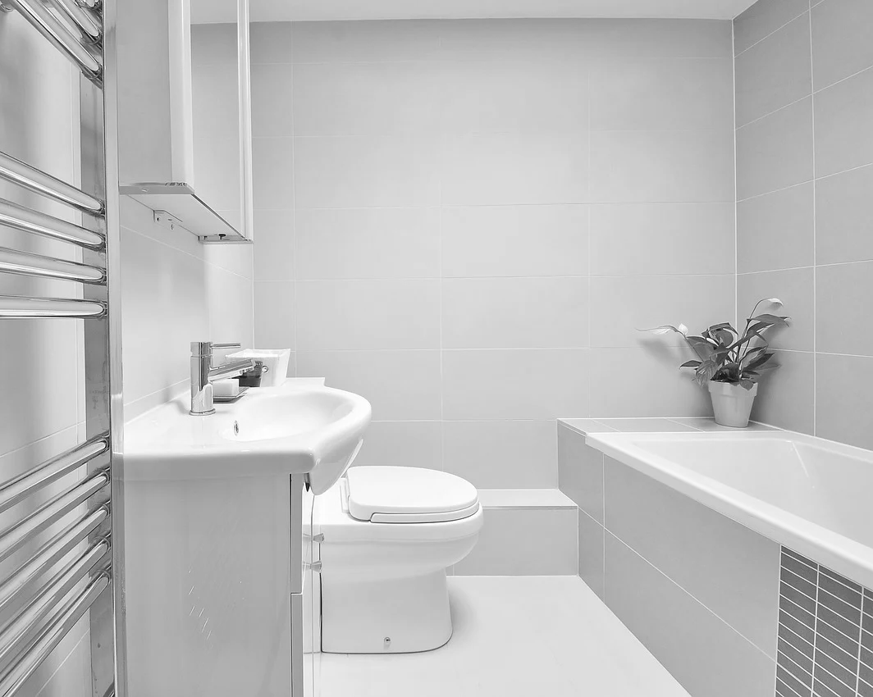
Bathroom spray
Notes:
You use bathroom spray in the bathroom

Slide 13
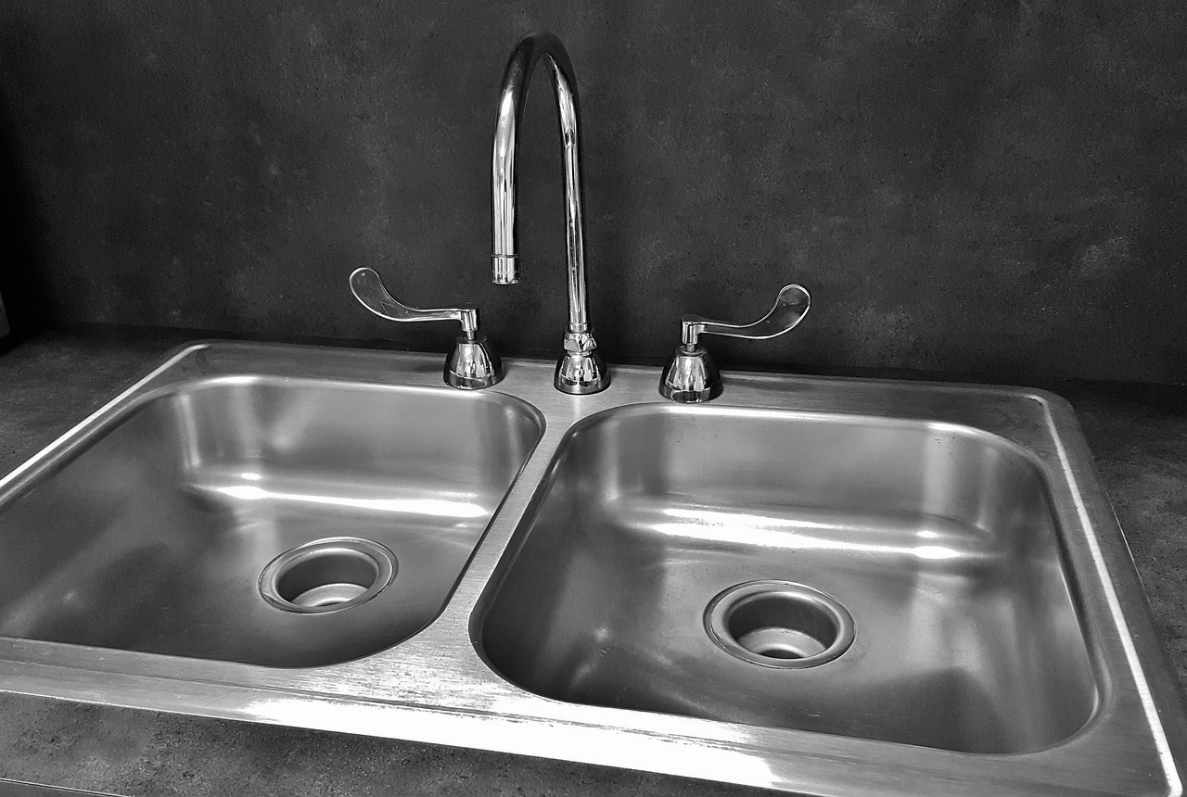
Washing up liquid and sponge
Notes:
You use washing up liquid and a sponge in the sink

Slide 14
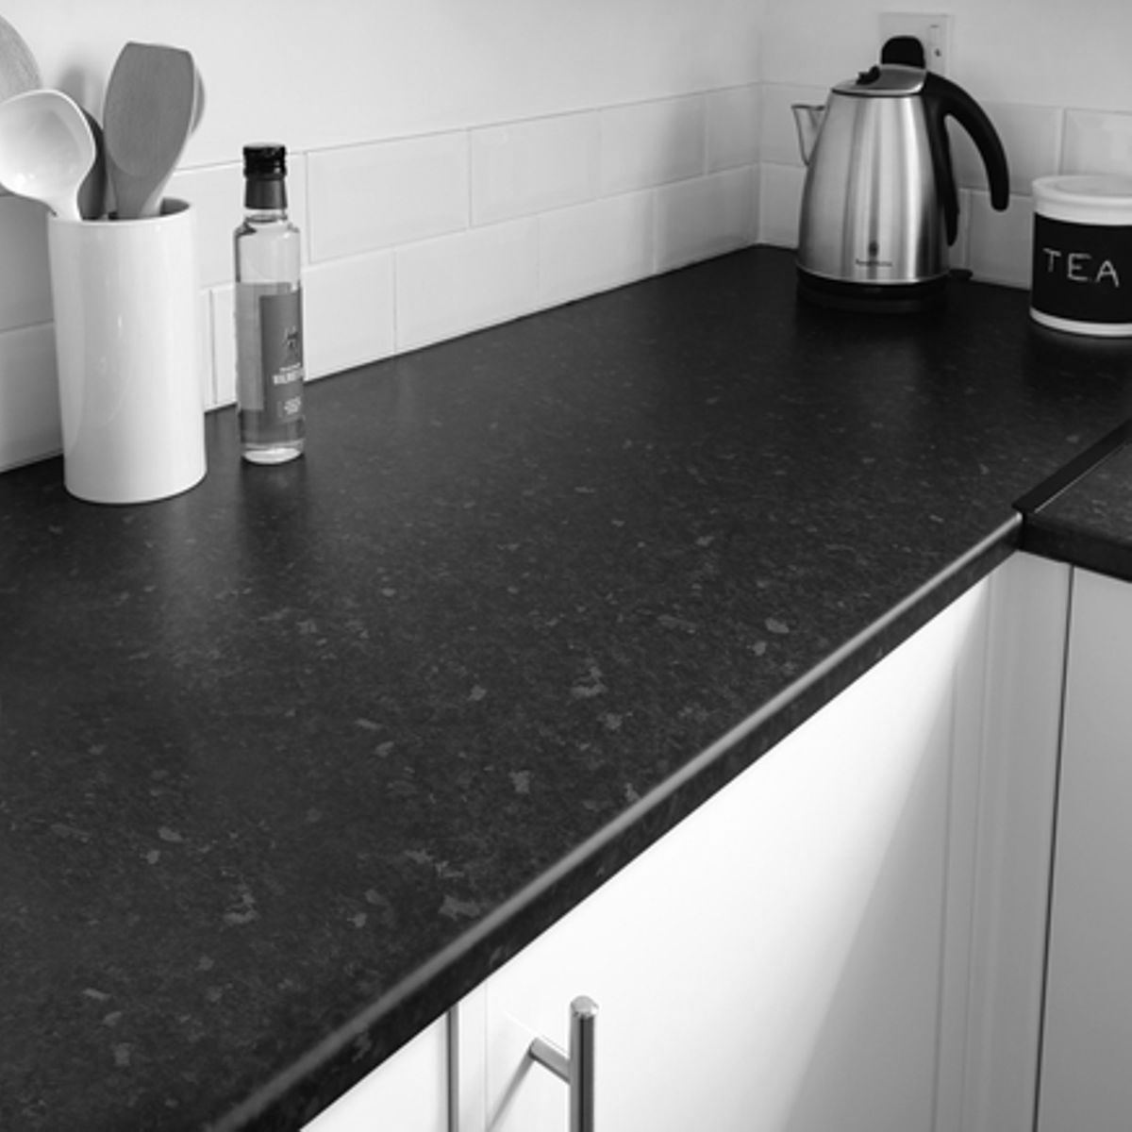
Wipes

Slide 15
Mop and dustpan and brush

Slide 16
Where can you use the items?
sink | kitchen surface | floor | bathroom
With a parent/ carer use the real objects one at a time and discuss where each cleaning product or equipment can be used e.g “where can we use the mop?”. Can you match the cleaning product to the place in the house? If you are working in the home, visit each area and model how to use the products and equipment in its real context.
Notes:
Use real objects one a a time to ask learners where they can use each cleaning product or equipment e.g “where can we use the mop?”. Can they match the cleaning product to the place in the house? If working in the home visit each area and model how to use the products and equipment in real context.

Slide 17
Independent Living: Home Management
Cleaning in the home
Make it easier
Make it harder
More ideas
Gather the items and cleaning products together in a pile. Ask your learner to put them away in the correct place. Use familiar products such as washing up liquid.
Write the labels of each item or cleaning product. Can your learner match the item or product to the correct label?
Visit the cleaning product aisle in the supermarket and model how to find out information from the cleaning product label e.g. looking at the image on the front.
Discuss the dangers of some cleaning products e.g. bleach.
Notes:
Final slide of the lesson. Suggest adaptations for teachers/parents.

Slide 18
Further Learning with Oak National
Independent Living:
Applying Learning- Using cleaning products (Unit 1)
Applying Learning- Hygiene at home (Unit 1)
Notes:
Insert info for subject/lesson name/stage (if appropriate)

Slide 19
References
Slide 9- Cleaning spray, Pxhere / Sponge, Pixabay/ Palmolive antibacterial dish liquid, NeoBatfreak, Wikimedia Commons/ Disinfectant wipes, Pixabay/ Mop, AwOc, Wikimedia Commons / Blue broom and dustpan, Santeri Viinamäki, Wikimedia Commons
Slide 12- Luxury bathroom. Pixabay
Slide 13- Basin sink kitchen, Pixabay
Slide 14- Kitchen worktop, Pixabay
Slide 15- Chairs floor furniture, Pixabay

