Slide 1
Plot a box plot and compare distributions
Maths
Miss Parnham

Slide 2
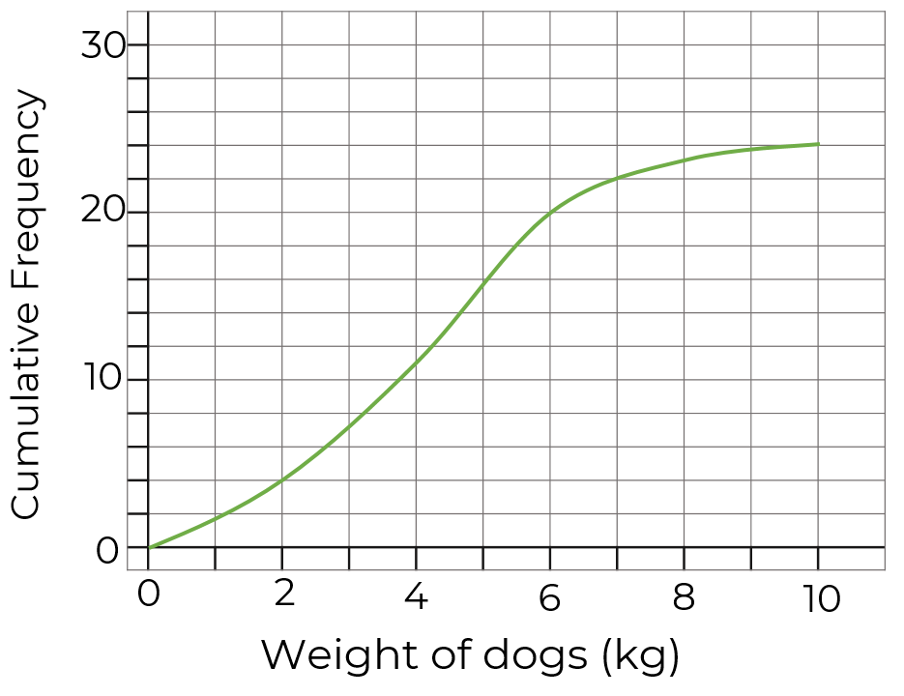
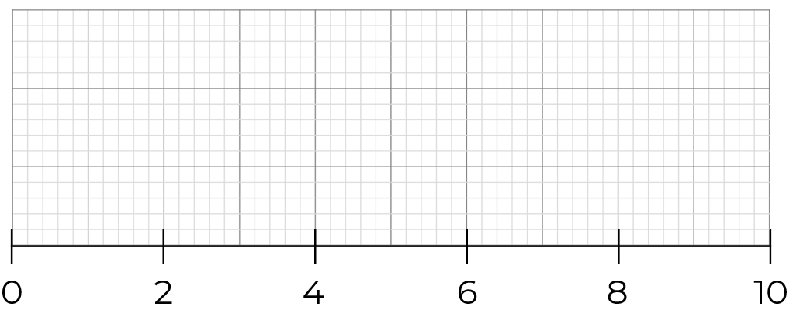
Plot a box plot and compare distributions
1. Complete the table for the daily rainfall recorded for one month.
2. Draw a box plot from the cumulative frequency diagram.
Minimum | Lower Quartile | Median | Upper Quartile | Maximum
Rainfall (mm)
Weight of dogs (kg)

Slide 3
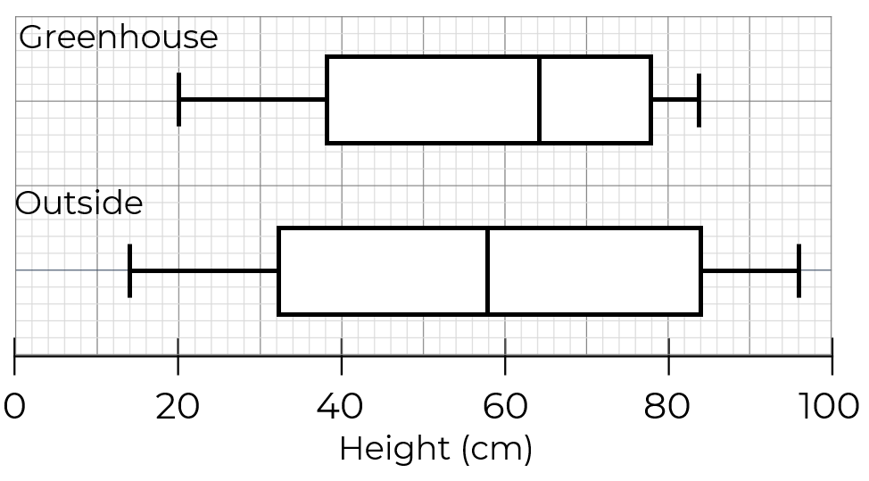
Plot a box plot and compare distributions
3. The box plots show the heights of tomato plants.
Complete the table and compare the two distributions.
 | Greenhouse | Outside
Median
Range
IQR

Slide 4
Plot a box plot and compare distributions
4. The table shows some information about the waiting times at a self-service check out.
Draw a box plot for the waiting times at a self-service checkout.
This box plot shows waiting times at a staffed checkout. Make 2 comparisons.
Minimum | Lower Quartile | Median | Upper Quartile | Range
7 | 16 | 28 | 50 | 48
Time (seconds)
Time (seconds)

Slide 5
Answers

Slide 6
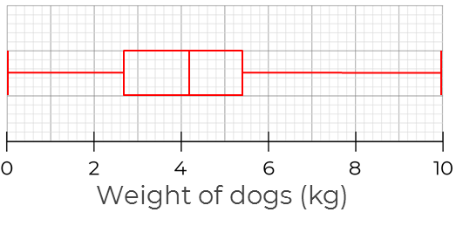
Plot a box plot and compare distributions
1. Complete the table for the daily rainfall recorded for one month
2. Draw a box plot from the cumulative frequency diagram.
Minimum | Lower Quartile | Median | Upper Quartile | Maximum
0 | 17 | 24 | 38 | 52
Rainfall (mm)

Slide 7
Plot a box plot and compare distributions
3. The box plots show the heights of tomato plants.
Complete the table and compare the two distributions.
 | Greenhouse | Outside
Median | 64 | 58
Range | 64 | 82
IQR | 40 | 52
Average height taller in greenhouse.
Greater range of plant heights outside.

Slide 8
Plot a box plot and compare distributions
4. The table shows some information about the waiting times at a self-service check out.
Draw a box plot for the waiting times at a self-service checkout.
This box plot shows waiting times at a staffed checkout. Make 2 comparisons.
Minimum | Lower Quartile | Median | Upper Quartile | Range
7 | 16 | 28 | 50 | 48
Time (seconds)
Average waiting time shorter at self-checkout.
Greater interquartile range of waiting times at self-checkout, less consistent.
Time (seconds)

