Slide 1
What are melting points and boiling points?
Downloadable Resource
Science
Miss Couves

Slide 2
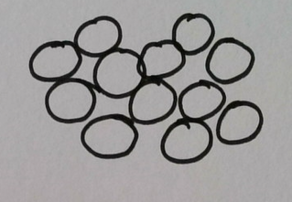
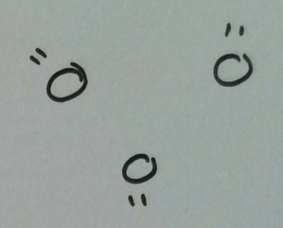
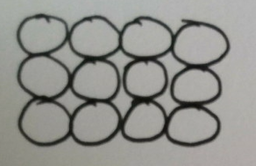
What do the particles look like in solids, liquids and gases?
Notes:
PP which of these diagrams shows a solid? How did you know?
PP What is the difference between the particles in a liquid and a gas?

Slide 3
Draw lines to match the description to the correct state of matter.
Solid |  | Particles are touching and in ordered rows
Liquid |  | Particles are far apart from each other
Gas |  | Particles are touching in a random arrangement

Slide 4
Draw lines to match the description to the correct state of matter.
Solid |  | Particles can slide past each other
Liquid |  | Particles are moving constantly in all directions
Gas |  | Particles cannot move but can vibrate

Slide 5
What happens to the particles as they are heated?
Solid
Liquid
Gas
___________ temperature - particles have _______ __________ - the substance ____________
Notes:
Particles in a solid are vibrating on the spot, in a liquid they are sliding past each other and in a gas they are moving fast in all directions. As a substance is heated the temperature increases. When the temperature increases the particles have more energy and move around more.

Slide 6
What happens to the particles as they are cooled?
Solid
Liquid
Gas
___________ temperature - particles have _______ __________ - the substance ____________
Notes:
Particles in a solid are vibrating on the spot, in a liquid they are sliding past each other and in a gas they are moving fast in all directions. As a substance is heated the temperature increases. When the temperature increases the particles have more energy and move around more.

Slide 7
Which state change does each arrow represent?
Solid
Liquid
Gas
Notes:
Pause the video and complete the diagram in your notes

Slide 8
How do we measure temperature?
1. What is temperature?
Temperature is a measure of ________________________________________________.
2. What scale do we normally use to measure temperature?
We normally use a scale called __________________ which is written as _______ .
3. How did scientists decide what 0 and 100 should mean in this scale?
0°C is the temperature that __________________________________________
100°C is the temperature that _________________________________________

Slide 9
Is water a solid, liquid or gas at 25 ºC?
Substance | Melting point (°C) | Boiling point (°C)
Water | 0 | 100
Aluminium | 660 | 2467
Chlorine | -101 | -35
Iodine | 114 | 184
Oxygen | -218 | -164

Slide 10
Is aluminium a solid, liquid or gas at 25 ºC?
Substance | Melting point (°C) | Boiling point (°C)
Water | 0 | 100
Aluminium | 660 | 2467
Chlorine | -101 | -35
Iodine | 114 | 184
Oxygen | -218 | -164

Slide 11
Is chlorine a solid, liquid or gas at 25 ºC?
Substance | Melting point (°C) | Boiling point (°C)
Water | 0 | 100
Aluminium | 660 | 2467
Chlorine | -101 | -35
Iodine | 114 | 184
Oxygen | -218 | -164

Slide 12
Is iodine a solid, liquid or gas at 100 ºC?
Substance | Melting point (°C) | Boiling point (°C)
Water | 0 | 100
Aluminium | 660 | 2467
Chlorine | -101 | -35
Iodine | 114 | 184
Oxygen | -218 | -164

Slide 13
Is oxygen a solid, liquid or gas at 0 ºC?
Substance | Melting point (°C) | Boiling point (°C)
Water | 0 | 100
Aluminium | 660 | 2467
Chlorine | -101 | -35
Iodine | 114 | 184
Oxygen | -218 | -164

