Slide 1
Lesson 5 - Plant cells
(Downloadable student document)
Science - Key Stage 3
Cells, Tissues and Organs
Miss Wickham

Slide 2
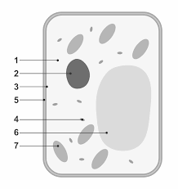
Label a plant cell with the organelles and their functions
8
Resume once you’re finished

Slide 3
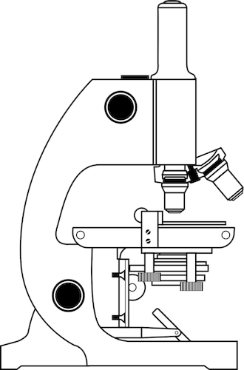
Recap on microscopes
Label the parts of the microscope using these key words: eyepiece lens, mirror, objective lens, coarse focus, stage, fine focus

Slide 4
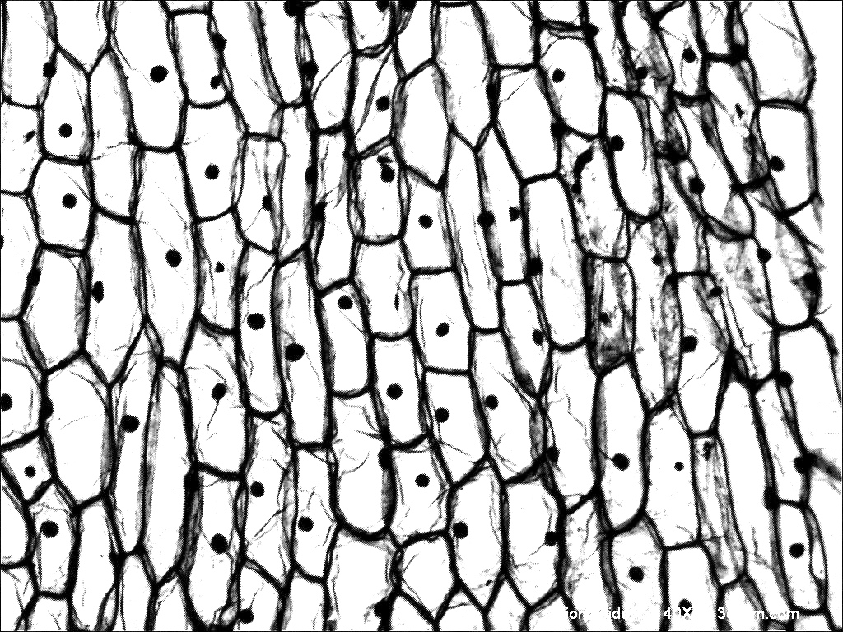
Looking at plant cells under a microscope
Answer the following questions:
Which organelles can you see?
Why might you not be able to see the other structures?
How are the cells arranged?

Slide 5
Pause the video to complete your task
Identify the errors in the following method for producing an onion slide
Cut the onion, taking off some of the onion flesh
Place onto the cover slip, making sure there is clear wrinkles
Add lots of drops of iodine to the onion
Place the glass slide over the cover slip quickly

