Slide 1
How has human use of materials changed over time?
Science
Miss Simkin

Slide 2
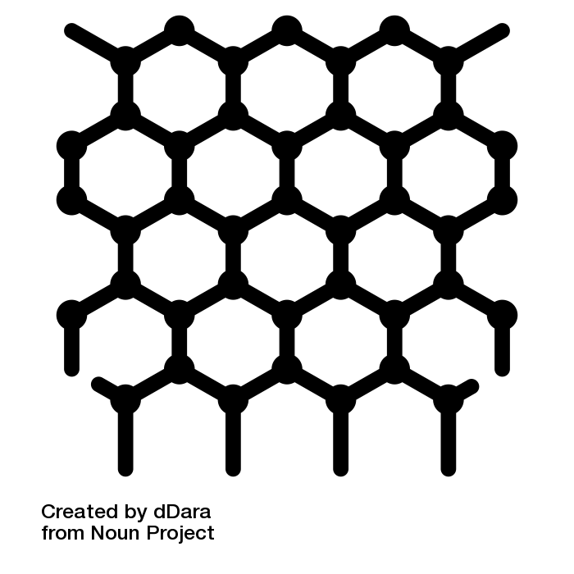
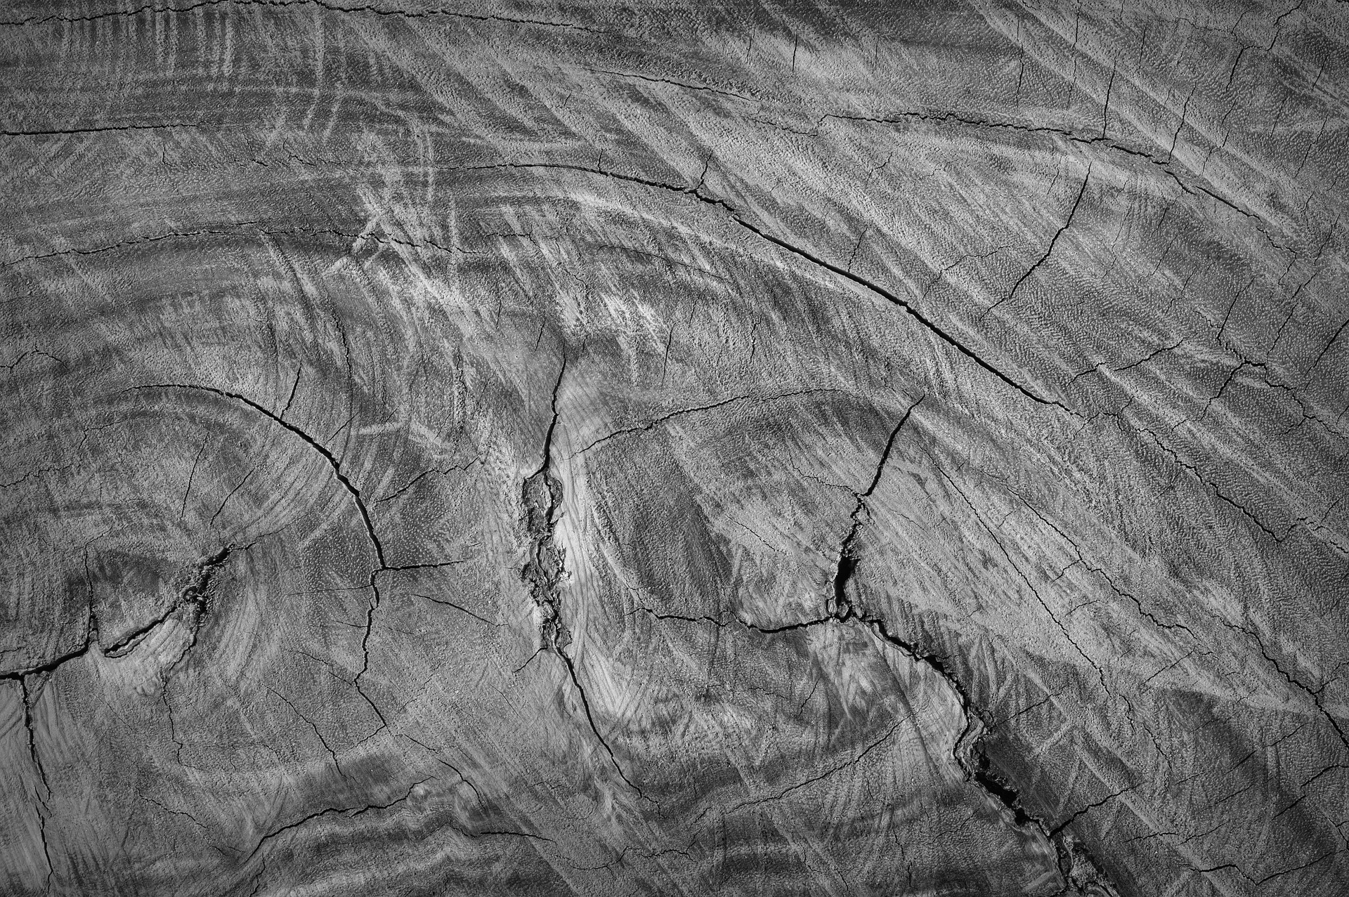
What was used first?
Put these in the correct order:
nanomaterials
bronze
paper
glass
wood
plastic
Nanomaterials - Noun Project - dDara, TH; all other images from Pixabay.
Notes:
Either from pixabay or referenced on last slide

Slide 3
Materials timeline
Answer the questions:
What was the difference in material use between the stone age and bronze age?
How is glass made?

Slide 4
Materials timeline
Answer the questions:
What is a nanomaterial?
Why are paper and plastic described as synthetic materials?

Slide 5
Materials timeline
Wood
Bronze
Glass
Paper
Plastic
Nanomaterials
Sort into natural or synthetic:

Slide 6
Debate
Make notes to support each side of the argument:
Humans have changed materials | Materials have changed humans

Slide 7
Debate
Answer the question:
Have humans changed materials or have materials changed humans?
Over the course of history it could be argued that__________ because ____________________. However, I think that the stronger argument is ______________________. This is because _____________________________________________________________.

