Slide 1
Lesson 6: Evaluating a Quiz
Selection in Quizzes
Computing
Josh Crossman
Materials from the Teach Computing Curriculum created by the National Centre for Computing Education

Slide 2
Task 1 - Identifying improvements
Add some notes about some problems a user may experience when using your quiz.
What could you add to help the user?

Slide 3
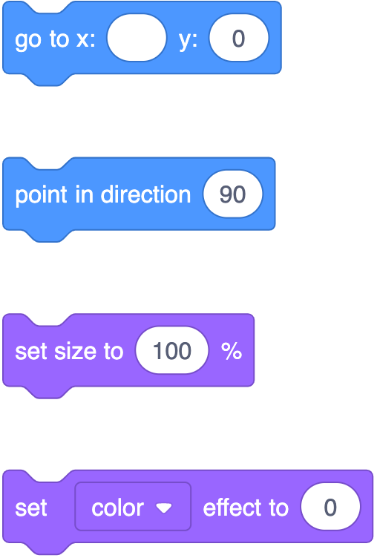
Task 2 - Setting Up
Which setup blocks will you need for your project?
Remember, even if only one of your outcomes does an action, you need to include it in the setup, just in case!
Credit: Scratch
Credit: Scratch

Slide 4
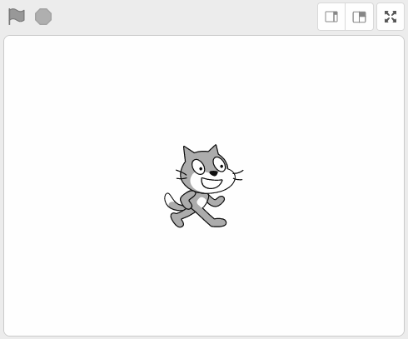
Task 3 - Extending your program
Open your project.
Implement any changes you have identified for your project!
Credit: Scratch

