Slide 1
Mathematics
Finding a percent of a quantity - problem solving
Mr Kelsall

Slide 2
New learning: practice
Find the percentages of £400
50%:
25%:
75%:
10%:
20%:
30%:
What other percentages can you find?
Notes:
These words will be used throughout the lesson

Slide 3
New learning: practice
There are 160 pupils at Wood Lane Primary School.
75% of pupils walk to school.
How many ways can you solve this question?
Notes:
These words will be used throughout the lesson

Slide 4
New learning: practice
Use this information to decide who did better in the penalty shootout
They each took 5 more shots. Who did better now?
Notes:
These words will be used throughout the lesson

Slide 5
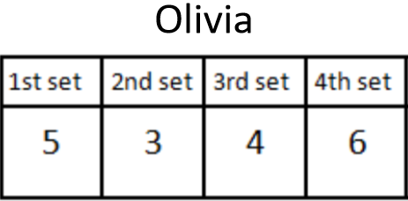
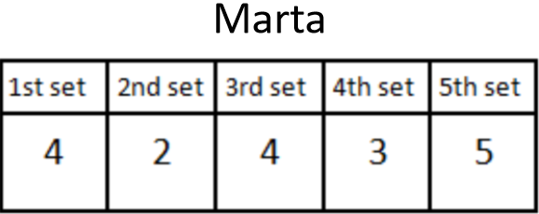
Develop learning: practice
Olivia and Marta are playing basketball.
Olivia scored 18 out of 24 and Marta scored 18 out of 30.
Are they equal?
Who has a better percent?
What are these as fractions?
Notes:
These words will be used throughout the lesson

Slide 6
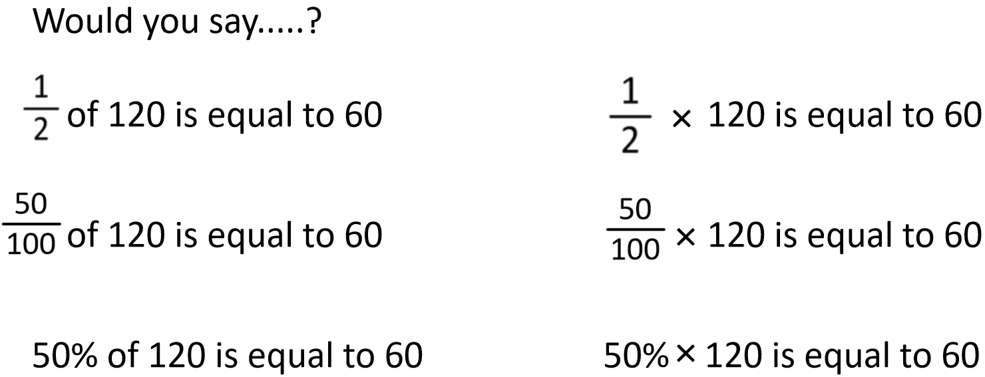
Independent practice
Source of all images : Mr Kelsall or Oak National Academy
Notes:
These words will be used throughout the lesson

