Slide 1
Using derived facts to
multiply and divide mentally
Worksheet
Mr Ward

Slide 2
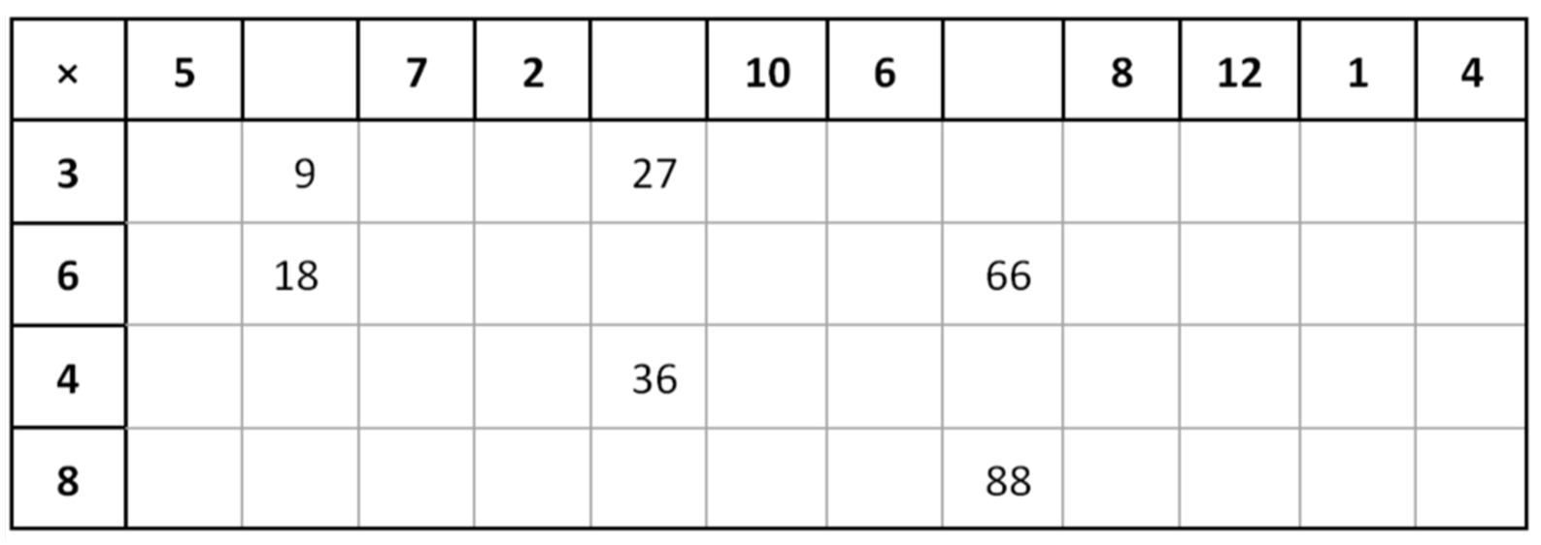
Warm up - Speedy Tables
Challenge: how many can you do in 3 minutes?

Slide 3
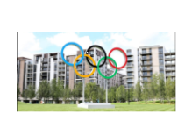
Using derived facts to multiply and divide
Have a go!
Choose a representation
In the athletes village, each apartment has eight athletes living in it.
How many athletes are there in 240 apartment?

Slide 4
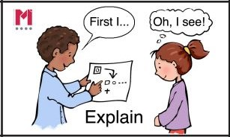
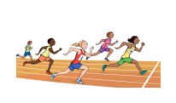
Talk Task - Independent work
To calculate mentally using derived facts
Multiplication problems
Represent each problem with an area model.
Record the steps of the strategy on an empty number line.
There are six athletes in each race and 26 races. How many athletes in total?
There are six athletes living in each apartment. How many athletes in 320 apartments?
There are six athletes living in each apartment. How many athletes in 834 apartments?

Slide 5
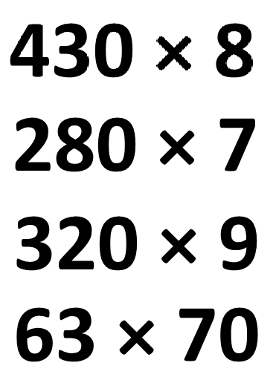
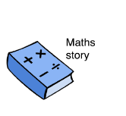
Representing mental strategies
Complete the calculations using different representations to show your strategies
Write a word problems based on a maths story for each calculation.
Cuisenaire rods
Array models
Dienes
Empty number line
Marked number line
Abstract number sentence

Slide 6
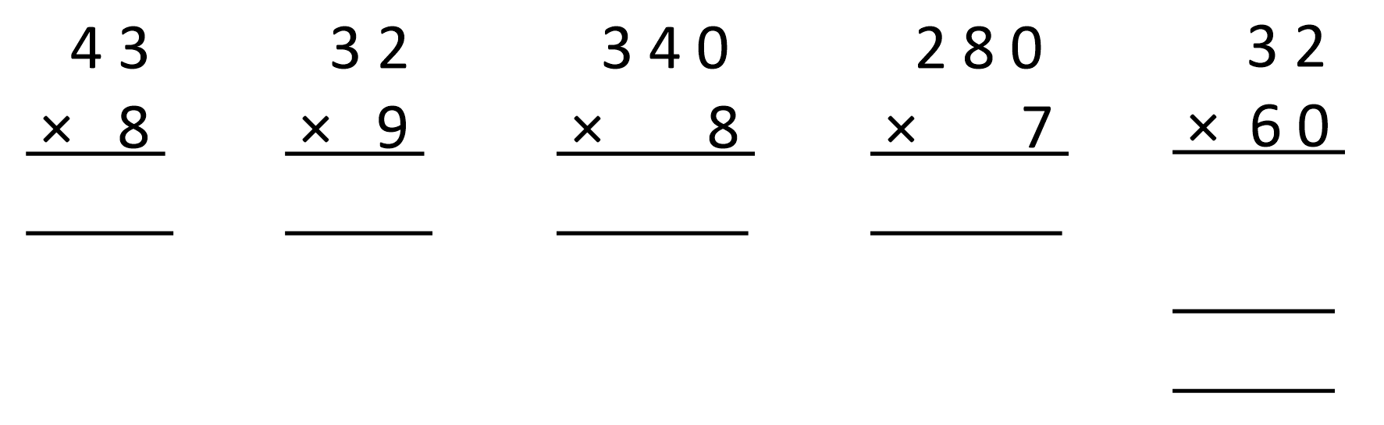
Challenge Slide
Multiplication Madness!
Complete the calculations and write a word problem for each one using maths vocabulary

