Slide 1
Fractions:
To revise fractions
Main Independent Activity
Maths
Ms Brinkworth

Slide 2
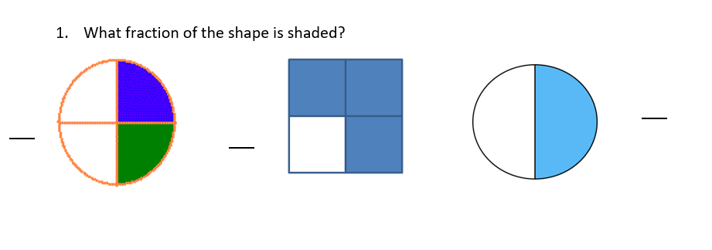
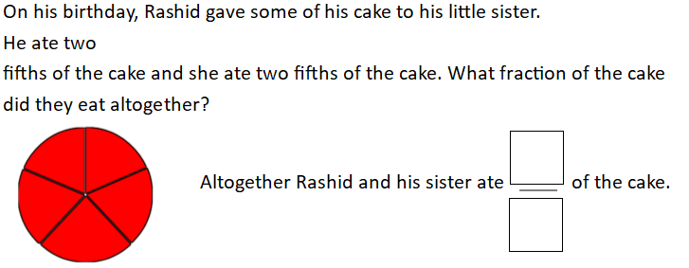
Part 1 Have a go at these questions
2. Which is greater?
or
3. Add these fractions
+ =
=
4. Subtract these fractions
- =
Challenge:
Notes:
Remember

Slide 3
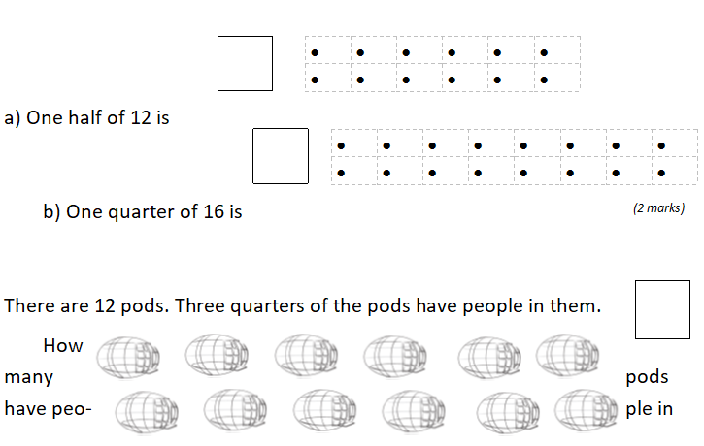
Part 2
9
Notes:
Remember

