Slide 1
Sketching quadratic graphs I
Mathematics
Mr Coward

Slide 2
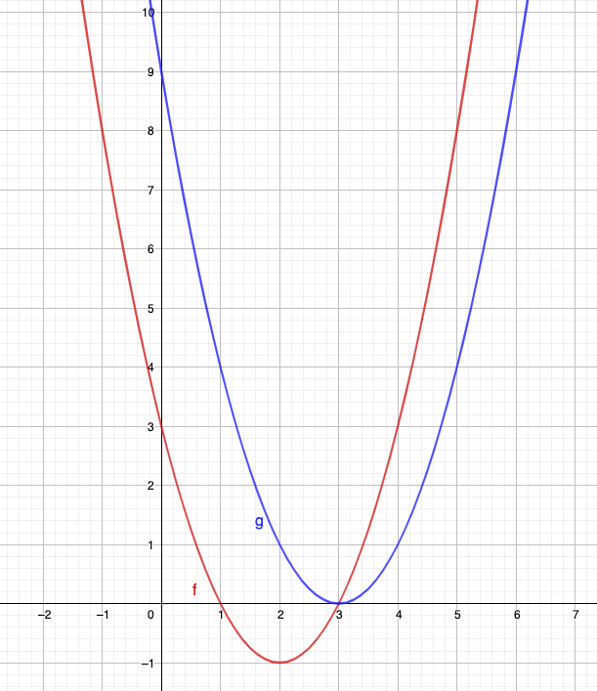
Try this
Notes:
Offer a hint showing how to start another example.
Talk about how we can use common factors e.g. (x+5) or (2x+10) etc
But we can also change it by rearranging

Slide 3
Independent task
1) Complete the table
Equation
Shape
Roots
Y-intercept
Notes:
These paths are of a movements going clockwise and anti clockwise from C. It might be a bit surprising to Ss that the totals aren’t equal. The other interesting thing is that the 6 bearings can be paired to make 6 sums of 360. Ss might be prompted to notice which pairs make 360 which is somewhat interesting too

Slide 4
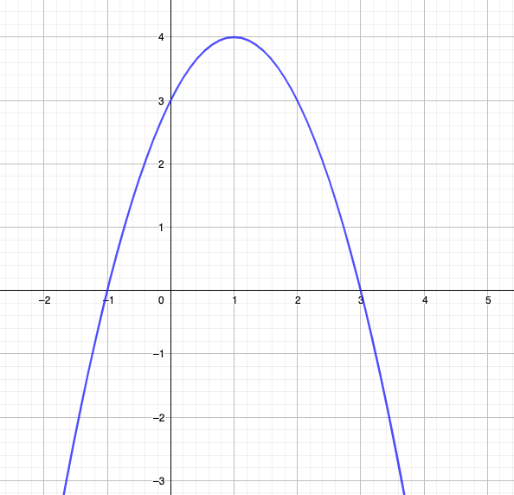
Explore
Notes:
Students may notice that 5/6 and 3/4 can also be compared by denominating by 12ths

