Slide 1
Reading Timetables
Worksheet
Mr Ward

Slide 2
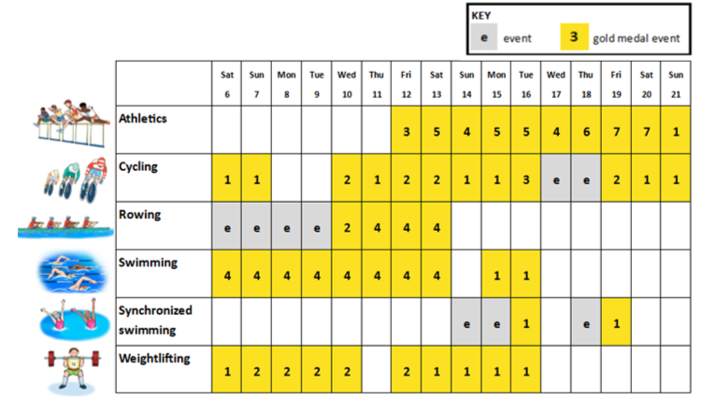
How many different examples can you think of from the world around us?
Read and interpret the timetable to answer the questions
What is the total number of gold medal events in each sport?
Across how many days do the events take place?
On what days do the most gold medal events happen?
Olympic Schedule Rio 2016

Slide 3
Olympic Schedule Rio 2016

Slide 4
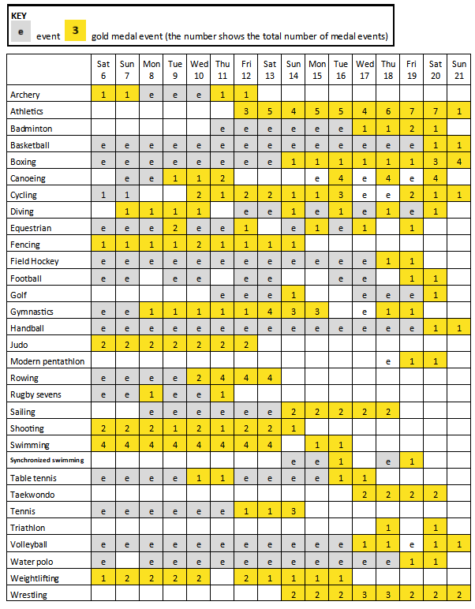
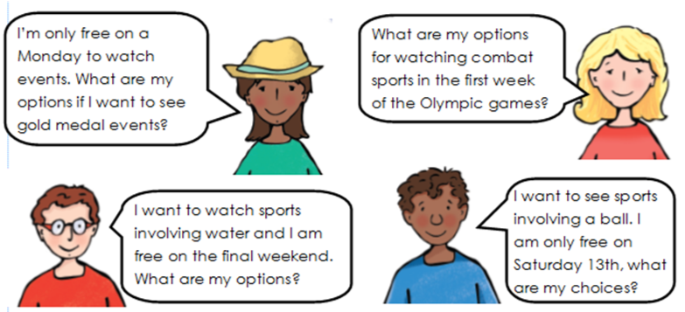
Your Task
Use the events timetable to provide accurate information in response to the questions posed by the four people below.

Slide 5
Key
Event
Gold Medal Event (the number shows the total number of medal events)

Slide 7
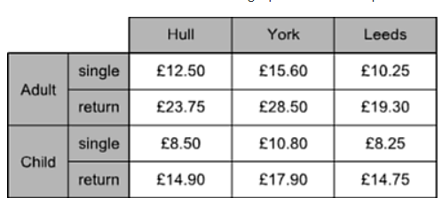
Challenge Slide
The table shows the cost of coach tickets to different cities.
What is the total cost for a return journey to York for one adult and two children?
How much would it cost for 1 adult and one child to take a day trip to Leeds?

