Slide 1
Future plans [2/ 2]
Using the simple future tense
French
Monsieur Lowe

Slide 2
Phonétique

Slide 3
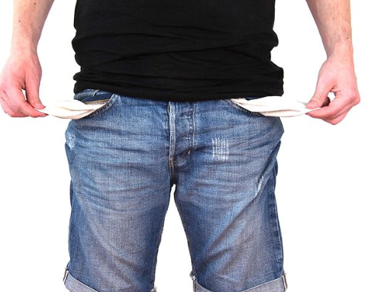
[ r ]
[ rr ]
rien
Notes:
Today’s phoneme is represented by the grapheme [r] or [rr]. The [r] or double [rr] makes a rrrr sound in French. Ecoute et répéte. Let’s consider a word which has this grapheme in it. What’s this person got in their pockets? This person has got nothing in their pockets. The French word for nothing contains the grapheme [r] Ecoute et répéte.
Now let’s look at some other words with this phoneme. I’ve chosen two words linked to our current topic area.

Slide 4
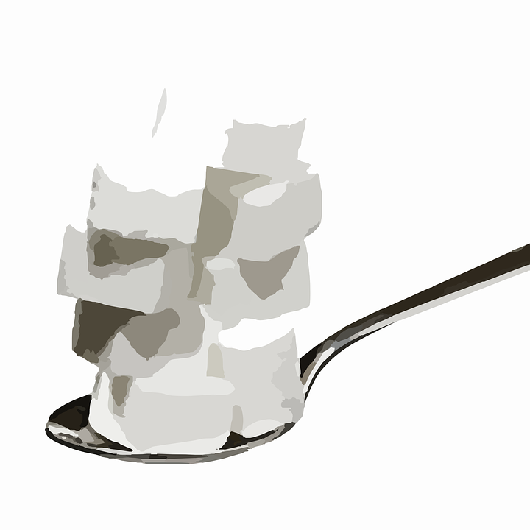
[ r ]
arriver
[to arrive]
rose
sucre
Notes:
Let’s look at the ‘r’ sound in the context of some vocabulary. RETURN.
Firstly, the French word for rose, rose. Ecoute et repete, rose. RETURN.
Secondly, the French word for sugar, sucre. Ecoute et repete, sucre. RETURN.
Finally, the French to to arrive, arriver. Ecoute et repete, arriver. RETURN.

Slide 5
f_ _r_/_n_/pr_m_n_de/à/p_ _d
f_ _r_/_n_/pr_m_n_de/à/ch_v _
f_ _r_/_n_/pr_m_n_de/à/v_l_
r_ndr_/v_s_t_/à
l_ _ _r
f_ _r_/d_/t_ _r_sm_
r_st_r/ch_z/m_ _
j_ _ _r/à/d_s/j_ _x/v_dé_s
f_ _r_/l_s/m_g_s_ns
_ll_r/_n/v_ll_
r_tr_ _v_r/m_s/_m_s
faire une promenade à pied
faire une promenade à cheval
faire une promenade à vélo
rendre visite à
louer
faire du tourisme
rester chez moi
jouer à des jeux vidéos
faire les magasins
aller en ville
retrouver mes amis
to go/going for a walk
to go/going horse riding
to go/going for a bike ride
to visit, visiting (people)
to rent/hire, renting/hiring
to go/going sightseeing
to stay/staying at home
to play/playing video games
to go shopping/shopping
to go/going into town
to meet/meeting my friends
Notes:
On the screen are all of the words that we have already encountered and they are all linked to the topic of weather. However, they are missing their vowels, so you need to put them in to spell the words correctly! For clarity, there is a forward slash to denote the space. You should pause the video to try and write the complete list. Met la video en pause maintenant.
Press RETURN. Did you get the same answers as my list? If so, super, but if not pause to make any corrections and highlight the words that you found tricky. Met la video en pause maintenant.
The final part of this activity is for you to translate the core vocabulary into English, met la video en pause.
Press RETURN. Here are the correct English translations for this vocabulary list. I am now going to call out the English and you should point to to the correct French word on the screen.
Comment dit-on … en francais? (Order - weather, to be hot, fod, to snow, to be nice/good weather, to be cold, wind, to rain, to be bad weather, sun, a storm)
If you need to write this vocabulary into your exercise books, press pause.

Slide 6
Grammaire The simple future tense

Slide 7
Using the simple future
Verbs with regular future stems
habiter
voyager
visiter
manger
regarder
louer
trouver
jouer
rendre = rendr-
lire = lir-
boire = boir-
Verbs with irregular future stems
The infinitive is used for
regular ER and IR verbs
avoir = aur-
être = ser-
faire = fer-
aller = ir-
voir = verr-
Some irregular verbs have irregular stems.
The infinitive minus E
for regular RE verbs
Notes:
Briefly recap the rules.
If you need to write these notes in into your exercise book, met la video en pause maintenant.

Slide 8
The simple future
Subject of the Sentence
The stem
Endings
Je | Regular ER and IR verbs Infinitive | ai
Tu |  | as
Il / Elle / On | Regular RE verbs Infinitive minus E | a
Nous |  | ons
Vous | Irregular verbs être = ‘ser’, avoir = ‘aur’, faire = ‘fer’ | ez
Ils / Elles |  | ont
I
You
He / She / You
We
You
They
Notes:
Briefly recap the rules.
If you need to write these notes in into your exercise book, met la video en pause maintenant.

Slide 9
Future plans
For irregular verbs we use
The simple future translates
J’irai =
Je ferai =
On ira =
On fera =
a stem not an infinitive
will NOT going to
I will go
I will do
We will go
We will do

