Slide 1
Exchange rates with graphs Lesson 3 of 8
Downloadable resource
Mathematics
Miss Kidd-Rossiter

Slide 2
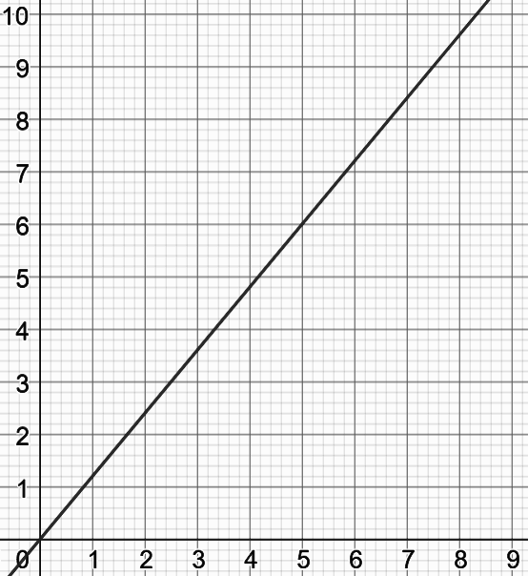
The graph shows the rate of exchange between pounds and euros.
How many ways can you complete these sentences?
€
For every ___ euros, I get ___ pounds.
For every ___ pounds, I get ___ euros.
The rate of exchange is ___ euros per pound.
The rate of exchange is ___ pounds per euro.
£

Slide 3
€
£
€
£

Slide 4
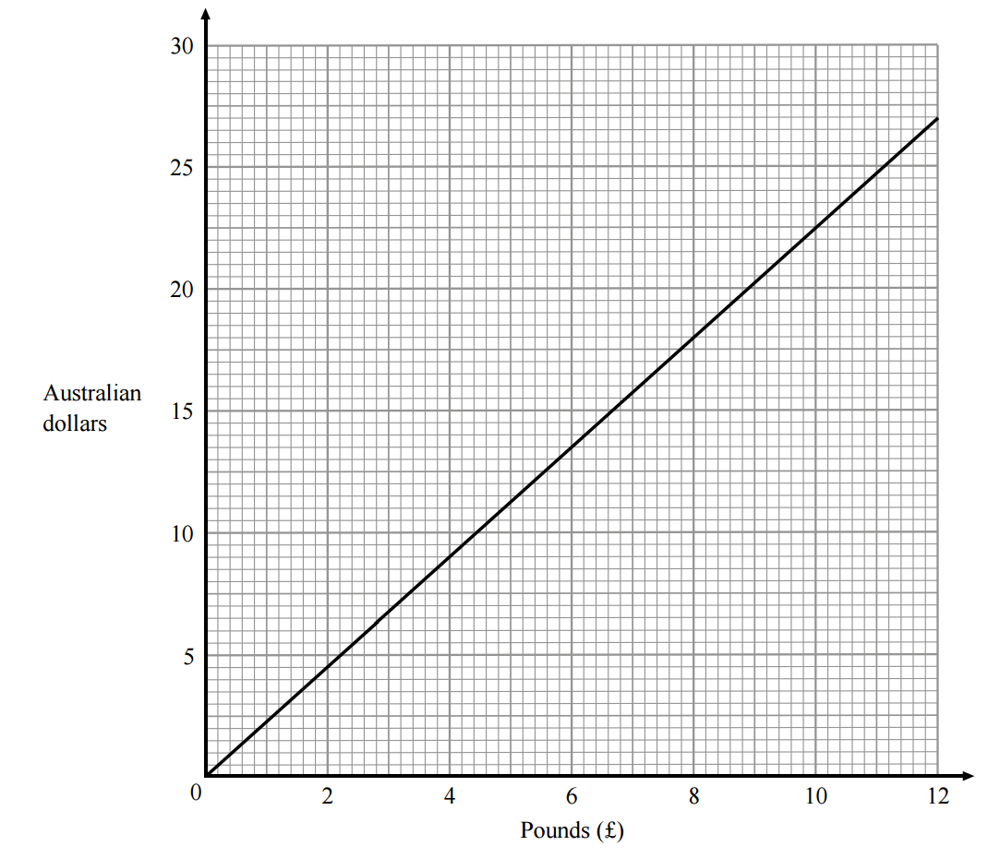
Use the conversion graph to work out the following:
Convert 20 Australian dollars to pounds.
How many Australian dollars is £1 worth?
How many pounds is one Australian dollar worth?
What is the exchange rate?
Convert £400 to Australian dollars.

Slide 5
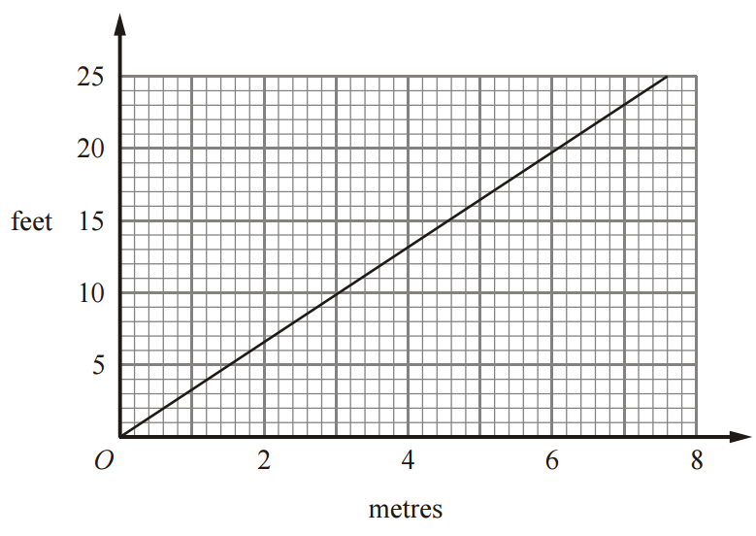
Use the conversion graph to work out the following:
Convert 10 feet to metres.
How many metres is 1 foot?
How many feet is 1 metre?
What is the conversion rate?
Convert 300 metres to feet.

Slide 6
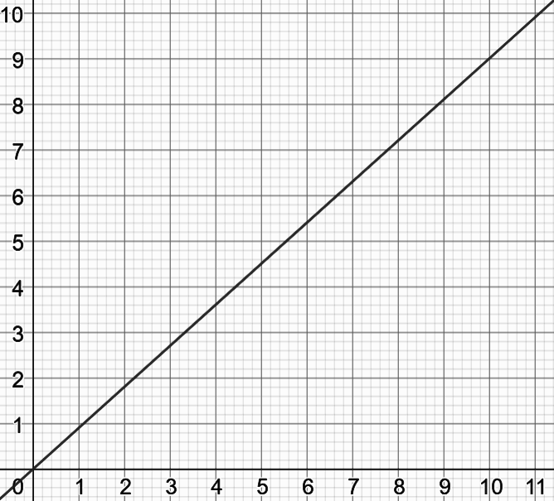
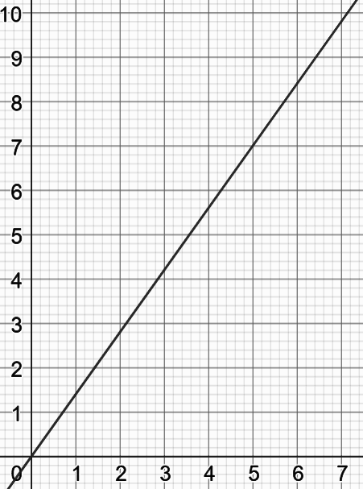
Which day is best to exchange your £ for €? What about exchanging € for £?
Zaki exchanged his £ for € on Day 1, but then cancelled his holiday and exchanged them back to £ on day 3. What happened to his money?
Day 1
Day 2
Day 3
€
€
€
£
£
£

