Slide 1
Lesson 2: How would you lay out your web page?
Web page creation
Computing
Jordan Bickel
Materials from the Teach Computing Curriculum created by the National Centre for Computing Education

Slide 2
Task 1: Design your own web page
Design your web page in the space provided. Include your logo, website name, header, text, and image choices.

Slide 3
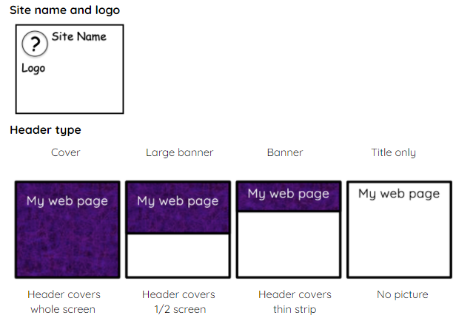
Task 1: Design your own web page
If using a blank piece of paper for your design, use the next two slides to support you in designing what your own web page will look like.

Slide 4
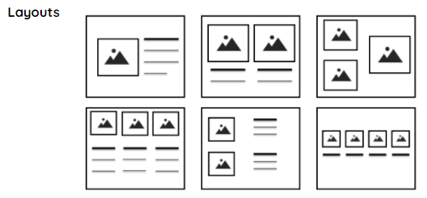
Task 1: Design your own web page
If using a blank piece of paper for your design, use the next two slides to support you in designing what your own web page will look like.

