Slide 1
Number Sense Application Lesson
Mathematics
Miss Hill

Slide 2
Independent Task
Can you find 10 or 100 more or less than given number?
 | 65 | 75 |  |  | 105
206 |  | 406 |  | 606
2. Fill in the missing gaps
10 less | Starting number | 10 more |  | 100 less | Starting number | 100 more
 | 325 |  |  |  | 419
674 |  |  |  | 89
 |  | 581 |  |  |  | 785

Slide 3
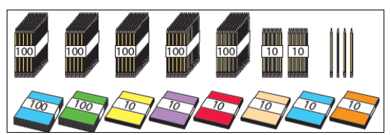
Independent Task
3. How many pencils do I have? _____________ How many exercise books? _______________ I give away 10 books to another class. How many do I have now? _________________ I buy 100 more pencils. How many do I now have? _______________________________

Slide 4
Independent Task
4. Using digit cards 0-9 can you make the answers to the questions below: 10 less than 8 + 7 10 more than 3 x 10 100 less than 336 100 more than 691 ____________________ ____________________ __________________ ____________________
5. Write the equation that comes next:
536-10=526 526-10=516 516-10=506 ___________________________

