Slide 1
Recount Writing: Captions for photos of a family holiday or day out
Communication and Language: Holidays - Applying Learning
Alison

Slide 2
For this lesson, you will need:
Photos or pictures of holidays
Scissors (parent / carer supervision is necessary)
Glue
Paper
Pencil or pen

Slide 3
Introduction to the lesson
In this lesson we are going to focus on recalling a familiar event. This could be a family holiday or recent day out.
We will use photographs and objects as reminders.
We will begin by looking at photographs or objects from the event.
To build up anticipation, the objects could be hidden in a box or bag and pulled out to explore.
We will then use questions to help to create captions for our story book.

Slide 4
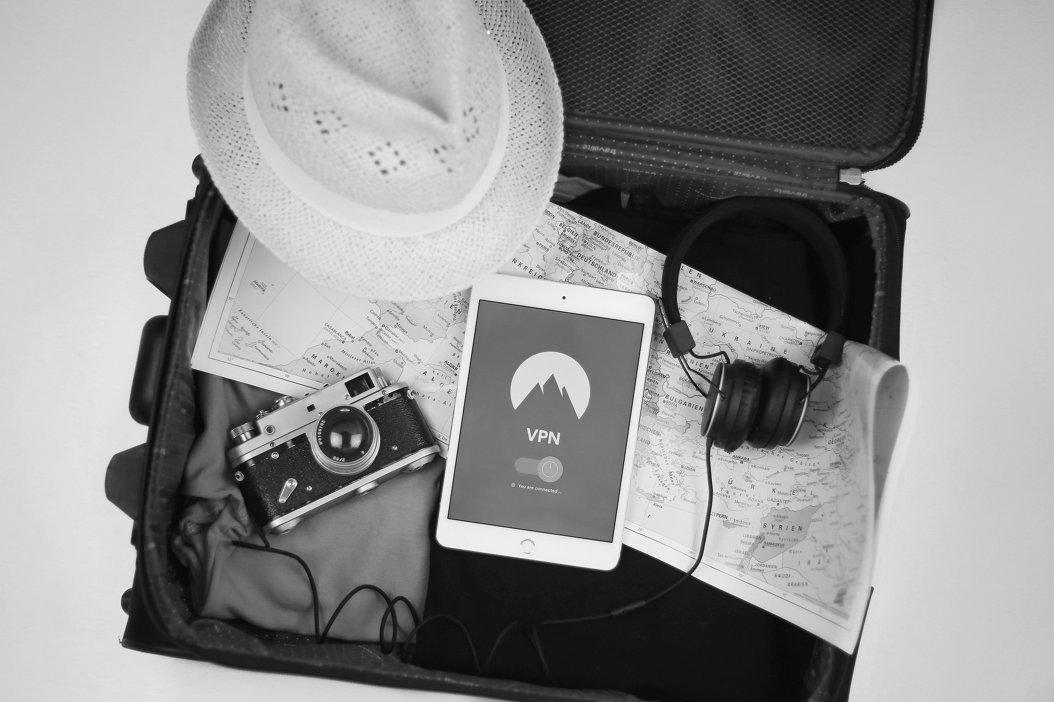
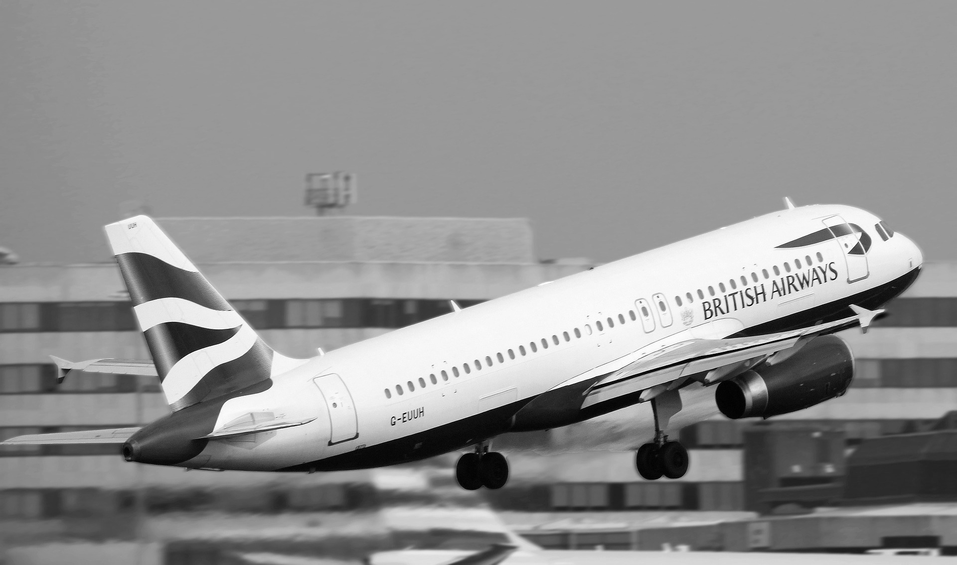
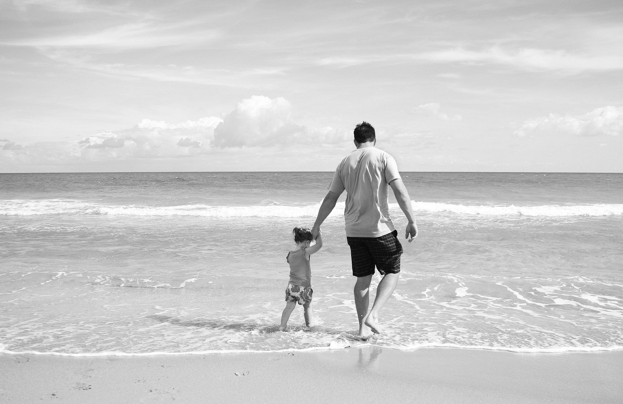
Recall
Arrange the photographs on the table.
Sequence the photographs in order.
Use questions to help.
Images from Pixabay

Slide 5
Creating a story frame...
To help write an account of the event, it might help to use a story frame. You can arrange your photos on a template or write the words in the boxes.
First
Next
Last

Slide 6
Now it’s time to complete the activity
Using the story frame
Draw or print the story frame
Using the pictures taken, sequence them in order. Use the language ‘first’, ‘next’, ‘then’, ‘last’

Slide 7
Adding the captions...
Look at the photos you have in sequences. Ask simple questions about the pictures. These can be found on the next page. Record the answers.
First
Next
Last
Images from Pixabay

Slide 8
Questions to ask
Look at photos of familiar holidays or days out.
Talk about:
Where did you go?
Who did you go with?
What did you do?
What did you like best?
What was the weather like?

Slide 9
Writing the captions
Using the caption prompts, can you add the missing word?

Slide 10
Now it’s time to complete the activity
Writing the captions
Underneath your pictures write your captions.
The captions could be pre-written to sequence or you could use key words.

Slide 11
Make it easier
Make it harder
More ideas
Use objects and symbols to support communication.
Limit the number of photos in the sequence.
Pre-write the captions to be sequences.
Reduce the prompts given.
Increase the number of photos in the sequence.
Provide less support when writing the captions.
Take photographs whilst on a walk, print out and sequence.
Make a photo book to record all the things you do over the year.
Read your book to family and friends.

