Slide 1
Shape and Symmetry:
To compare and order angles
Independent Task
Mathematics
Mr Critchlow

Slide 2
To Start
How many of the shapes can you name?
1
2
3
4
5
6
7
10
8
9

Slide 3
To Start
How many of the shapes can you name?
Shape number | Name | Shape number | Name
1 |  | 6
2 |  | 7
3 |  | 8
4 |  | 9
5 |  | 10

Slide 4
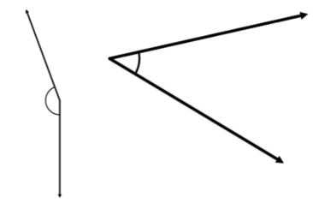
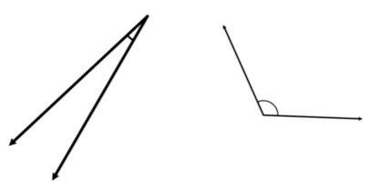
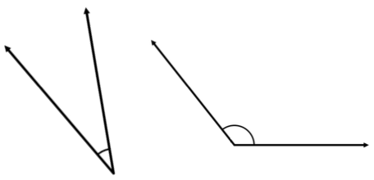
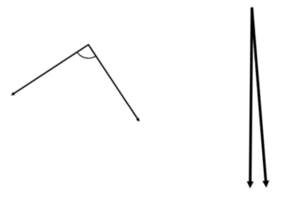
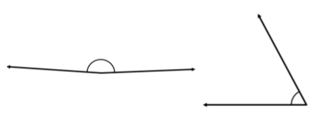
Moving on
Tick the angle in each pair that is larger. If you are unsure try using an angle finder (explained in the lesson)
Can you spot the right angle? Circle it

Slide 5
Main Task
For each set of angles, decide which is the smallest. Number this 1. Then number 2, 3 and 4 from smallest to largest. (1 = smallest, 4 = largest)

Slide 6
Main Task
For each set of angles, decide which is the smallest. Number this 1. Then number 2, 3 and 4 from smallest to largest. (1 = smallest, 4 = largest)

Slide 7
Main Task - extension
Which 3 angles do you think are closest to being right angles? Circle the 3 you think

