Slide 1
Developing Problem Solving Skills
Mathematics
Lesson 9 of 10
Ms.Dobrowolski

Slide 2
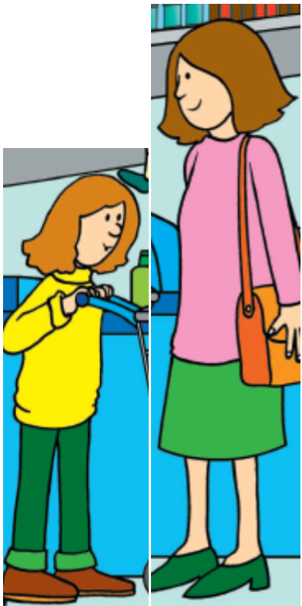
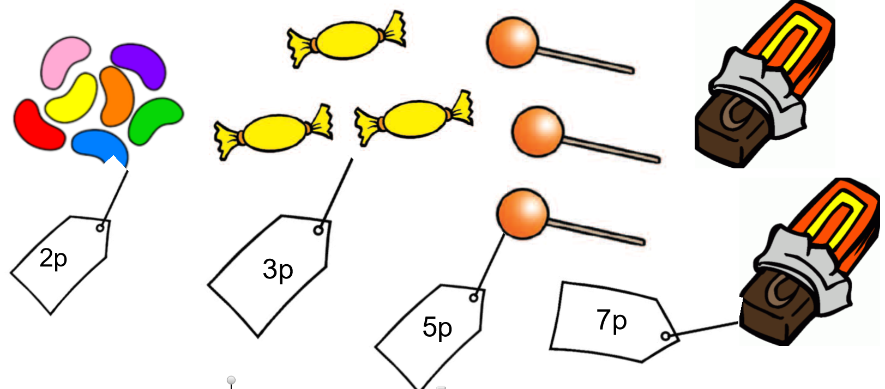
Independent Task-Part 1
Emily and her mum went to buy some sweets too.
They EACH had 20p to spend and they both spent all of their money.
Emily bought at least one kind of each sweet. Which one did she have two of?
What information do you know?
What do you need to know?
What problem solving strategies might help you?

Slide 3
Independent Task-Part 2
Emily and her mum went to buy some sweets too.
They EACH had 20p to spend and they both spent all of their money.
Emily’s Mum spent her money on just one kind of sweet, but she does not like jelly beans. Which sweets did she buy?
What information do you know?
What do you need to know?
What problem solving strategies might help you?

