Slide 1
To find the total cost of two items
Independent Task
Maths
Mrs Bramble and Miss Charlton
Notes:
Today’s independent task is about you choosing two items from the price list and then adding them together to find out how much they cost.
You can then have a go at seeing what coin combination you can make to make that amount. You don’t need actual coins to do the second part of the task, you could draw them yourself.

Slide 2
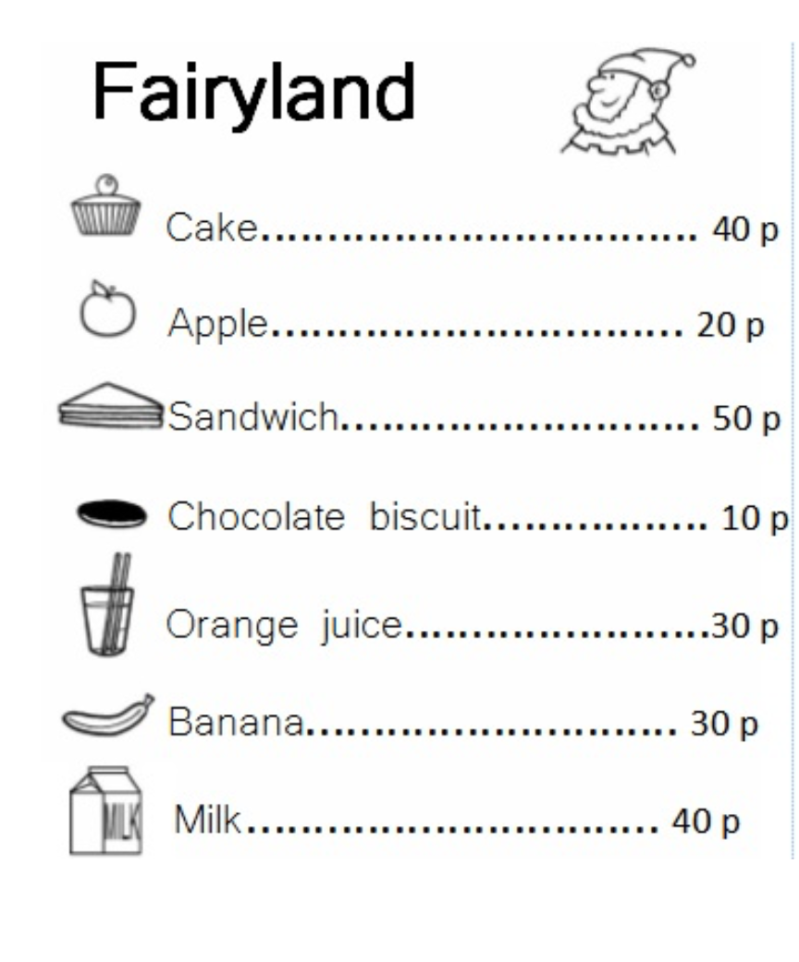
Independent Task
How many different pairs of items can you find the cost of?
Notes:
Today’s independent task is about you choosing two items from the price list and then adding them together to find out how much they cost.
You can then have a go at seeing what coin combination you can make to make that amount. You don’t need actual coins to do the second part of the task, you could draw them yourself.

Slide 3
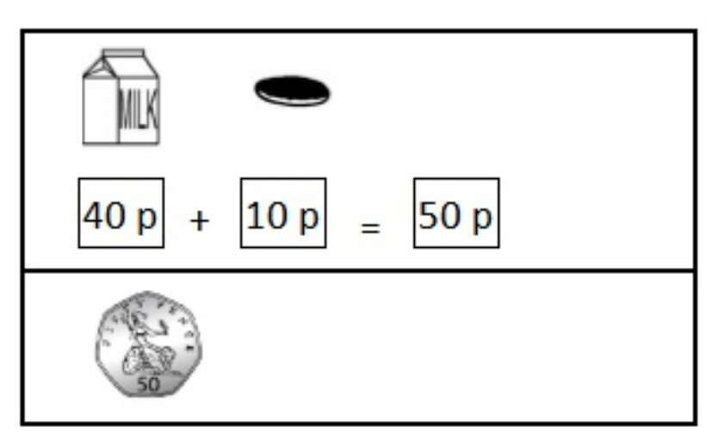
Independent Task Example

Slide 4
Independent Task Support

Slide 5
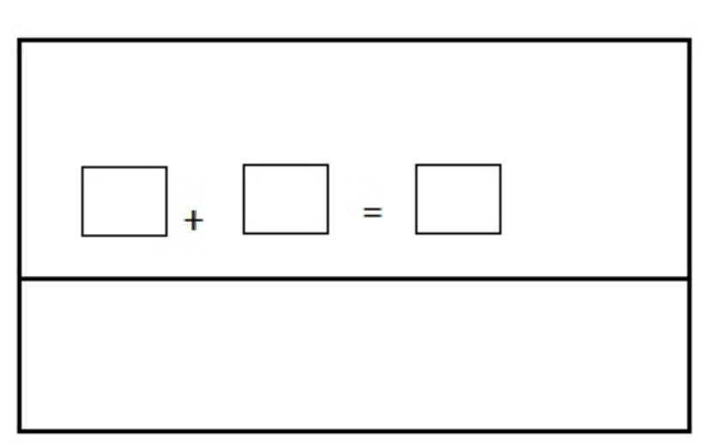
Independent Task Support

