Slide 1
Saying what you and others do at
home (Part 1/2)
1st and 2nd person present tense singular weak verbs
Downloadable Resource
German
Frau Johnson

Slide 2
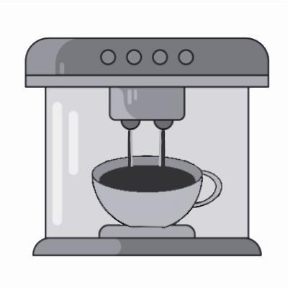
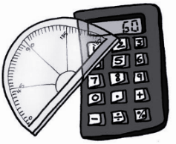
ch
machen
nochmal
Buch
acht
Nacht
Fach
Notes:
German has two distinctly different sounds that are represented by the letter combination ch.The so-called back ch is pronounced in the back of the mouth. It is usually preceded by a, o, u, or au. Although this sound does not exist for most English speakers, it does occur in Scottish English in words like Loch (as in Loch Ness). This is the sound you hear in Buch.. Can you feel the sound in the back of your throat? Let’s go through some of those words now so you can get a feel for the sound. Buch wiederhole .. Buch, acht wiederhole acht, machen wiederhole machen, nochmal wiederhole nochmal, Nacht wiederhole Nacht, Fach wiederhole Fach

Slide 3
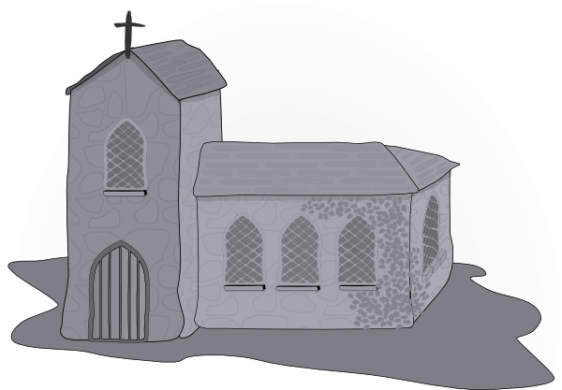
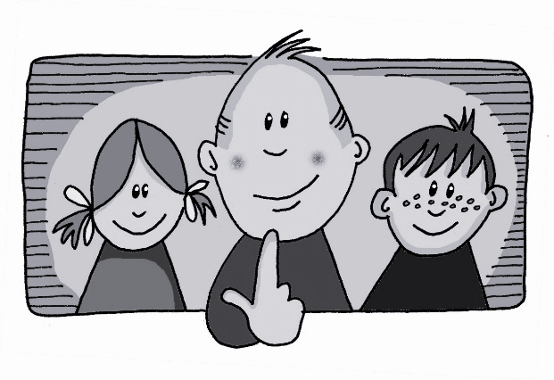
Licht
ch
Kirche
ich
nicht
endlich
manchmal
[finally]
[sometimes]
Notes:
The front ch, produced in the front of the mouth, follows all other vowels and diphthongs and also occurs at the beginning of a word. The front ch is similar to the English h in huge. This sound occurs in the German word ich. Let’s look at some words that contain this sound. Endlich wiederhole, licht, wiederhole, Kirche, wiederhole, nicht, wiederhole, manchmal, wiederhole

Slide 4
Present Tense ‘Weak’ Verbs
In German the verb ending often tells us who is doing the action.
The infinitive is the dictionary form.
Infinitive
gehen
to go
1st person
I go
Ich gehe
2nd person
Du gehst
you go
Notes:
Info comes in one by one. Infinitive, then infinitive bubble, then verb forms

Slide 5
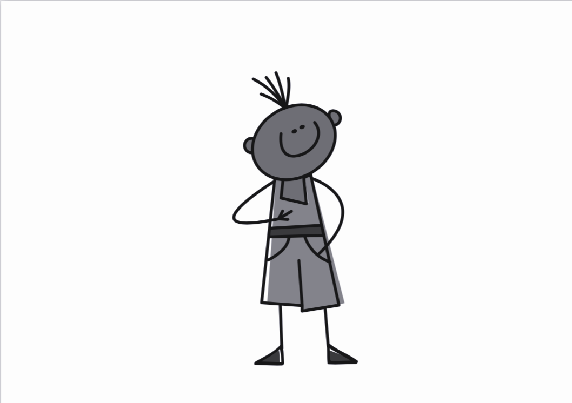
Present Tense Weak Verbs
The term ‘weak’ is another way of describing regular verbs.
For ‘I’ you remove the -en from the infinitive and add an -e with the pronoun.
hören
hören
hör
ich höre
X
to listen
I listen
Notes:
Information comes in one by one.

Slide 6
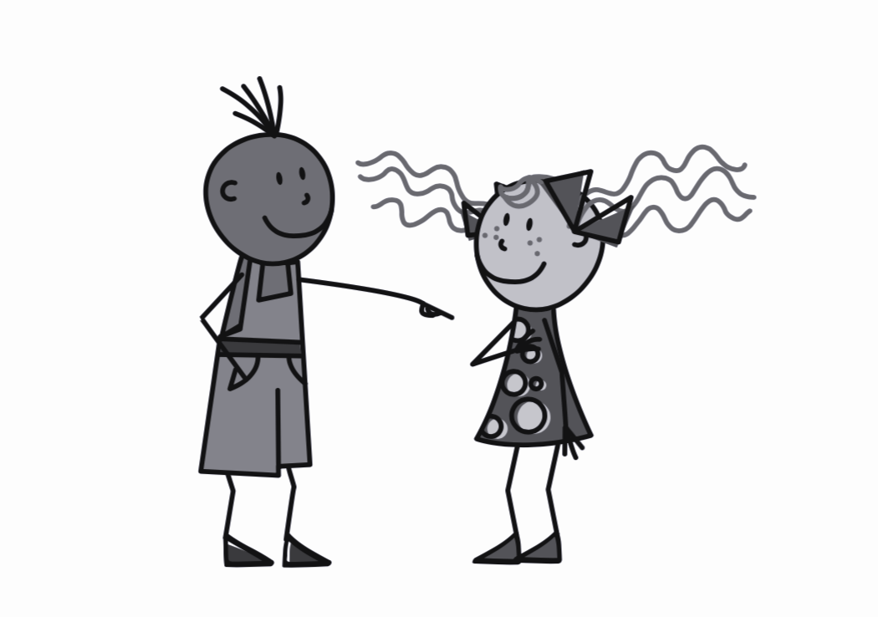
Present Tense Weak Verbs
For ‘you’ you remove the -en from the infinitive and add an -st with the pronoun.
hören
hören
hör
du hörst
X
to listen
you listen
This pattern is the same for all weak (regular) verbs.
Notes:
Information comes in one by one. Remember last part about the pattern.

Slide 7
Extra information
If a verb stem ends in a ‘z’ then you don’t add an ‘s’ in the du form.
For example:
du sitzt
sitzen
sitz
This rule will be the same with tanzen and putzen.
Notes:
And one other thing

Slide 8
Extra information
If a verb stem ends in a ‘t’ then you add an ‘e’ in the du form.
For example:
du arbeitest
arbeiten
arbeit
Notes:
There are a couple of extra pieces of information you need to know about the verbs we are looking at today before we do some practice.

Slide 9
Saying what you and others do at home
1 In German regular verbs are sometimes called ______ verbs.
2 When you use ich the ending is an _____.
3 When you use du the ending is _____.
4 In the du form if a verb stem ends in ‘z’ you don’t add ‘st’ you just add ____.
5 In the du form if a verb stem ends in ‘t’ you add an ____ before the ‘st’ ending.
weak
e.
st.
t.
e
Notes:
Now it’s time to summarise what we have learnt today. Read the sentences

