Slide 1
Find probabilities from Venn Diagrams including basic set notation
Maths
Mrs Dennett

Slide 2
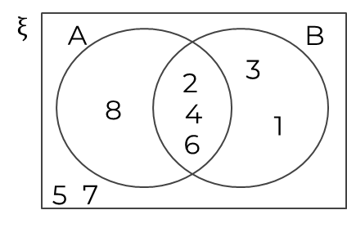
Find probabilities from Venn Diagrams
1. 15 children were asked if they played cricket or badminton.
7 children played both, 3 children played neither and 9 played cricket.​
a) Draw a Venn diagram to represent this information.​
b) A child is chosen at random. Calculate the P(A child who plays badminton is chosen).
2. The Venn diagram represents the following sets.​
ξ = { 1,2,3,4,5,6,7,8 }​
A = { 2,4,6,8 }​
B = { 1,3 }​
a) Calculate the P(A ∪ B).
b) Calculate P (A’)

Slide 3
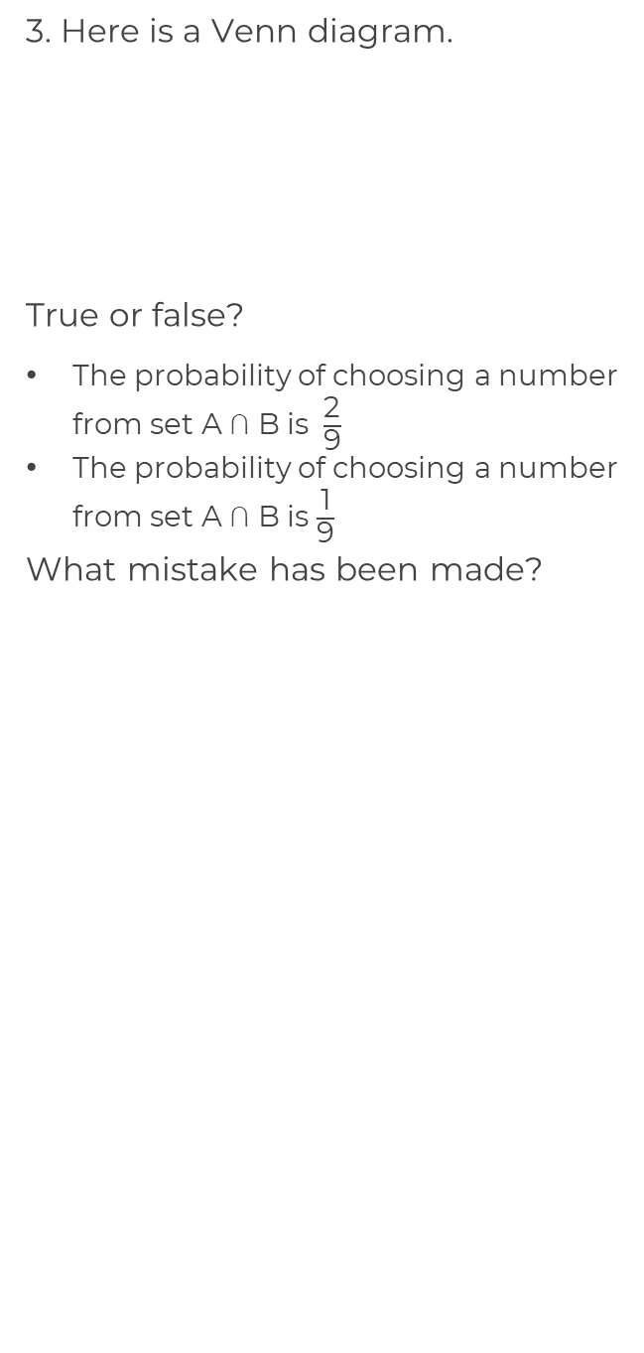
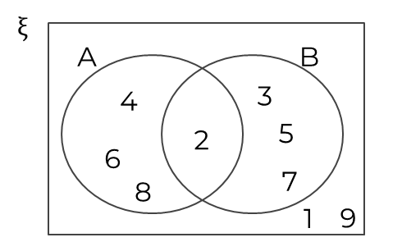
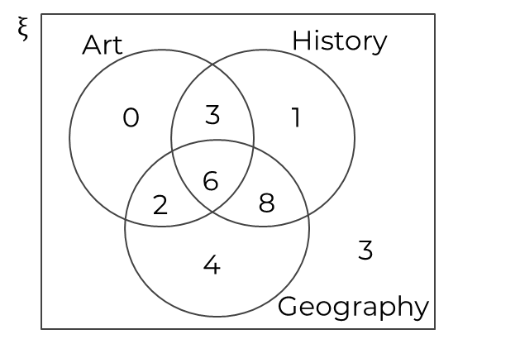
Find probabilities from Venn Diagrams
4. This Venn diagram shows the number of students who study art, history and geography.
A student is chosen at random.
Work out
a) P(Geography ∩ History)
b) P(Art ∩ History)
c) P(Art ∩ Geography ∩ History)

Slide 4
Answers

Slide 5
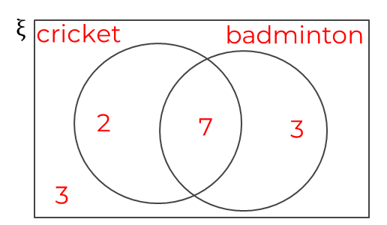
Find probabilities from Venn Diagrams
1.
a) Draw a Venn diagram to represent this information.​
b) A child is chosen at random. Calculate the P(A child who plays badminton is chosen).
2. The Venn diagram represents the following sets.​
ξ = { 1,2,3,4,5,7,8 }​
A = { 2,4,6,8 }​
B = { 1,3 }​
a) Calculate the P(A ∪ B).
b) Calculate P (A’)

Slide 6
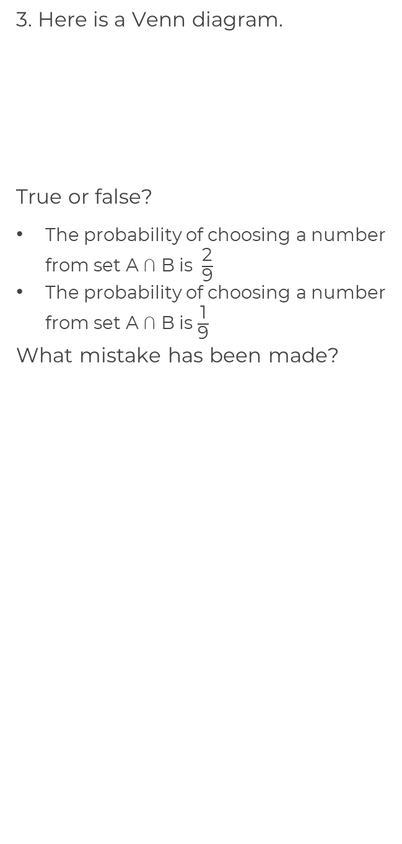
Find probabilities from Venn Diagrams
4. This Venn diagram shows the number of students who study art, history and geography.
A student is chosen at random.
Work out
a) P(Geography ∩ History)
b) P(Art ∩ History)
c) P(Art ∩ Geography ∩ History)
False
True
There is only 1 number in the intersection

