Slide 1
Say how many there are [2/ 2]
Introducing ‘il y a’
Plural indefinite article/numbers
French
Madame Sooden

Slide 2
[ a ]
malade
sac
mal

Slide 3
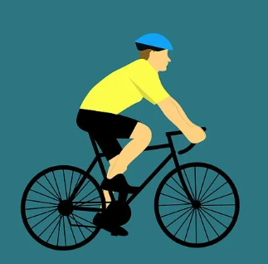
[ y ]
cyclisme

Slide 4
[ i ]
midi

Slide 5
[ i ]
ici
qui ?
il

Slide 6
Vocabulary list for this lesson:
une plage | a beach
un village | a village
des champs | some fields
un livre | a book
il y a | there is/are
sept | seven
huit | eight
neuf | nine
onze | eleven
douze | twelve
5
4
3
2
1

Slide 7
Indefinite articles
 | Masculine | Feminine | Plural
Definite the | le | la | les
Indefinite a | un | une | des

Slide 8
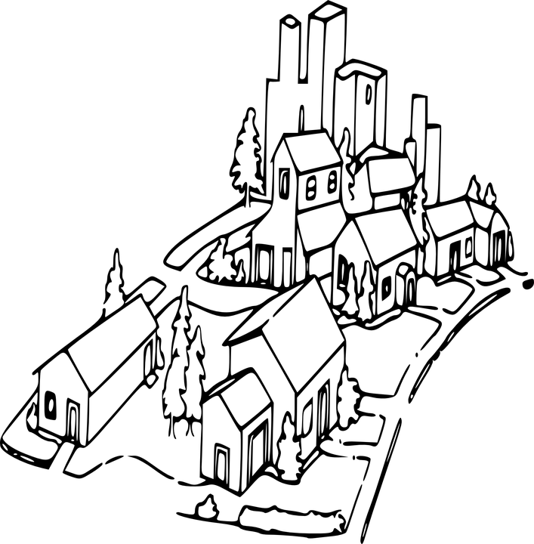
Il y a
There is or there are
Il y a une plage
Il y a des champs
Il y a un village
Il y a is followed by a word to show how many items there are.
This is likely to be un / une / des

Slide 9
Il y a
There is or there are
Il y a un champ
There is one field
Il y a six champs
There are six fields
x6
x6

Slide 10
Say how many there are
1 | Name a feminine indefinite article.
2 | Name a masculine indefinite article.
3 | How can you translate ‘il y a’?
4 | What can you replace an indefinite article with?
5 | Translate ‘sept villages’ into English.
6 | Translate ‘douze livres’ into English.
une
un
there is/are
a number
7 villages
12 books

