Slide 1
Talking about the school day [1 / 3]
present tense “er” and “ir” verbs in third person: singular and plural
French
Madame Hedley-Smith

Slide 2
Écoute et compare:
Je joue
Tu joues
Il joue
Elle joue
Ils jouent
Elles jouent

Slide 3
finir | to finish
étudier | to study
porter | to wear
commencer | to start
durer | to last
redoubler | to retake
le cours | lesson
la récré | breaktime
l’élève | pupil
les grandes vacances | summer holidays
The infinitive can also be translated by the gerund.
Finir = to do finish AND finishing

Slide 4
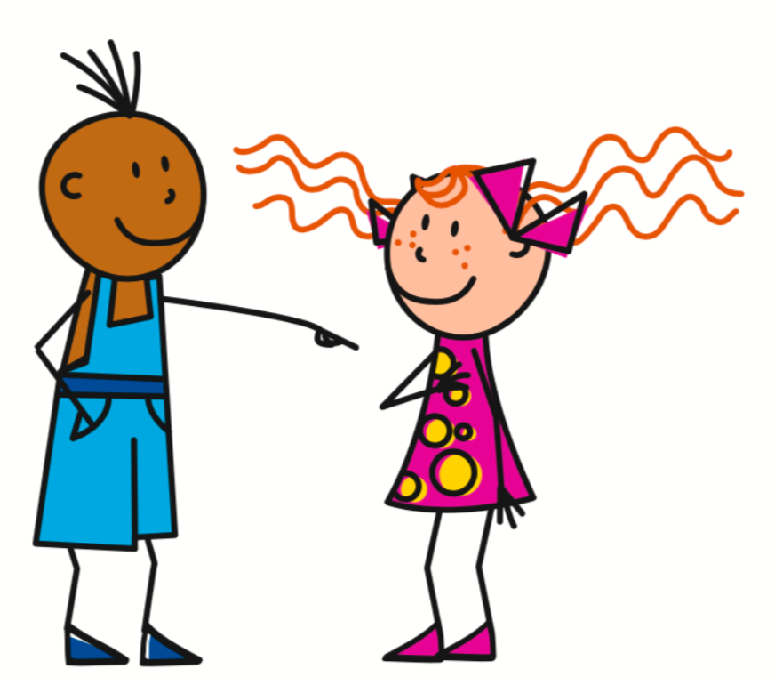
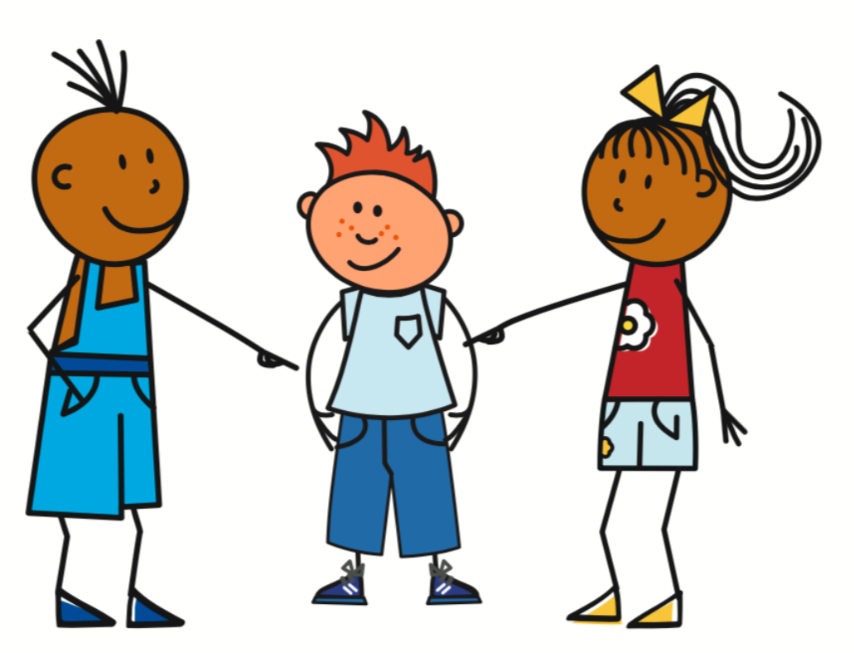
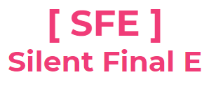
Present Tense - Regular -er verbs
To form the present tense with a regular ER verb, remove the ER from the infinitive and add the correct ending.
Étudier - To study
J’étudie - I study
Nous étudions- We study
Tu étudies - You study
Vous étudiez - You (pl) study
Il/Elle étudie - He/she studies
Ils/Elles étudient - They study

Slide 5
Present Tense - Regular -ir verbs
To form the present tense with a regular IR verb, remove the IR from the infinitive and add the correct ending.
finir - To finish
Je finis - I finish
Nous finissons - We finish
Tu finis - You finish
Vous finissez - You (pl) finish
Il/Elle finit - He/she finishes
Ils/Elles finissent - They finish

Slide 6
Descriptions of French school
The verb “redoubler” means =
2. The third person singular ending of an “er” verb =
3. The third person singular ending of an “ir” verb =
4. The third person plural ending of an “er” verb =
5. The third person plural ending of an “ir” verb =
to retake
-e
-it
-ent
-issent

