Slide 1
Subtracting Negative Numbers Worksheet
Mathematics
Mrs Buckmire
Notes:
Pen and paper and encourage to pause

Slide 2
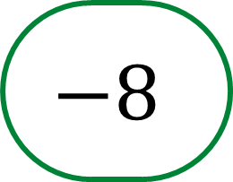
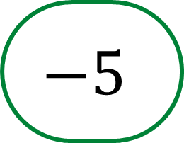
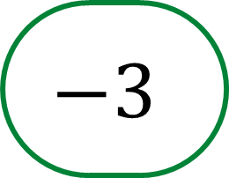
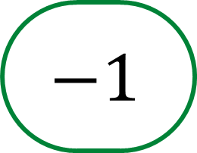
Try this
How many ways can you put the integers
in to the inequality to make it true?

Slide 3
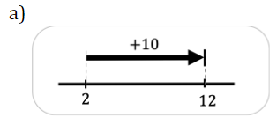
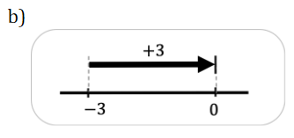
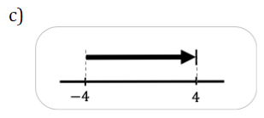
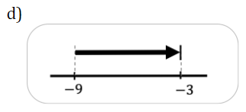
Independent task
For each of the number lines write down two calculations, an addition and a subtraction:
2. Identify the equal pairs of calculations, you do not need to calculate the value. a) 7 - (-6) b) -6--7 c) (-6)-(-6) d) 6+(-6)
e) (-6)+6 f) (-6)+7 g) 6+6 h) 7+6
3. Calculate each of the following subtractions:
90- (-100) b) 90-100 c) -90-(-100) d) (-90)-100
e) 100-90 f) 100-(-90) g) (-100)-90 h) (-100)-(-90)

Slide 4
Explore
What’s the same and what’s different about each of the following calculations?
Which of these number lines could be used to represent them?

