Slide 1
To place numbers one to six in order.
Mathematics
Mrs Harris

Slide 2
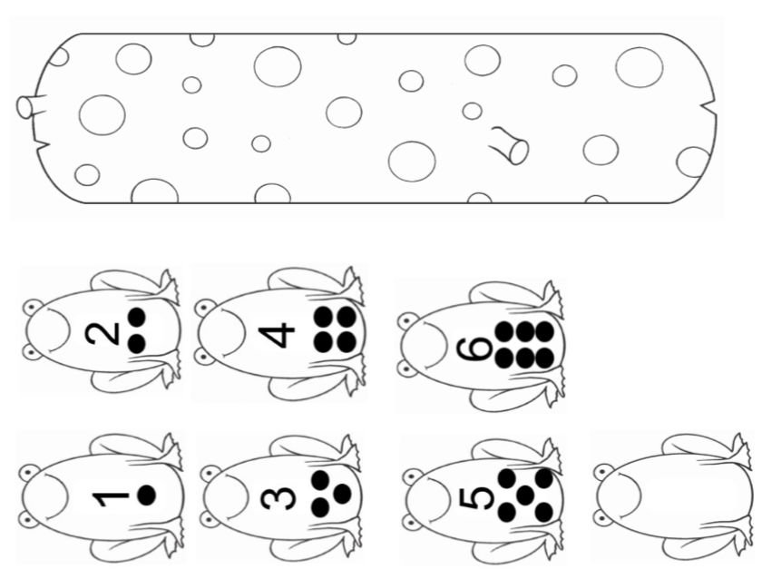
Notes:
Use speckled frogs video

