Slide 1
Transcription How to write a postcard
Communication and Language: Holidays - Applying Learning
Leanne

Slide 2
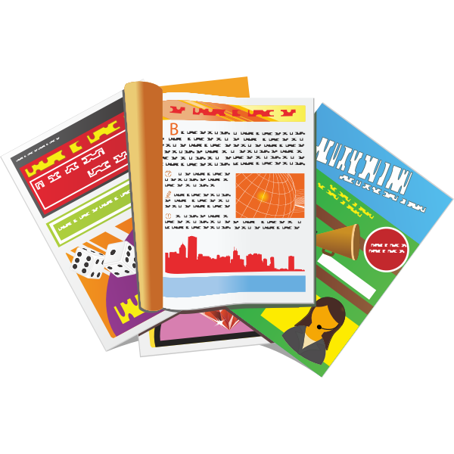
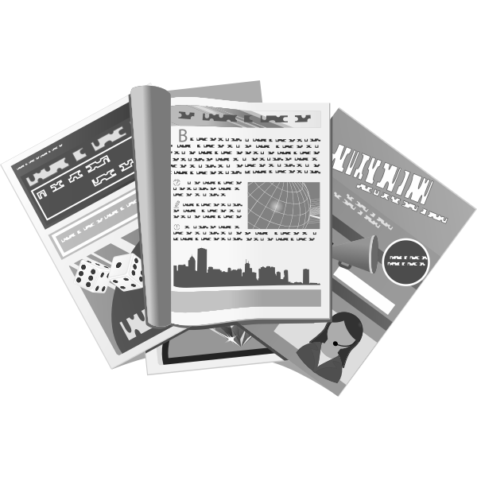
Equipment for this lesson
In this lesson you will need:
Paper
Pencil or pen
Scissors (parent / carer supervision is necessary)
Coloured pencils
Holiday magazines
Photos or pictures of holidays
Glue
Images from Pixabay, FreeSVG
Notes:
You will need your sketchbook, a pencil, some clay, either natural earthen clay or air drying clay, clay tools and a smooth surface to work on. Cover the surface with a slightly dampened material such as a tea towel or you can use a plastic place mat. As you may get a bit messy when working with clay it is best to wear an apron or an old t-shirt or shirt.

Slide 3
Introduction to the lesson
In this lesson we are going to be making a postcard.
A postcard is a card with a message on one side and a photograph or picture on the other side.
We might send postcards to family and friends when we are on holiday.
Do you have any postcards in your home you can look at?

Slide 4
Using a writing frame
Before we start the lesson, we need to prepare our writing frame for our postcard.
Writing frames can support the learner by structuring their writing and indicating which information goes where.
Use your ruler to draw the writing frame.
Dear
Name
Message
Address
From

Slide 5
Writing a postcard
Now it is time to decide who you would like to write a postcard for.
When you have decided, write their name in the top box.
You can now also write your own name in the bottom box.
Dear Auntie Viv
Name
Message
Address
From Leanne

Slide 6
Writing a postcard
Dear Auntie Viv
Now you know who you are sending it to, you can add their address.
Auntie Viv
Message
9 Long Lane
London
From Leanne

Slide 7
Message ideas
Think about a recent holiday or day out. Discuss the following:
Where did you go?
Who did you go with?
How did you get there?
What did you do?
What was your favourite part of the trip?
What was the weather like?
Images from Pixabay

Slide 8
Message ideas
When you have discussed the questions, start building sentences.
I went to Brighton.
I went with Mum and Dad.
We travelled by car.
Yesterday we went swimming.
Use as much support as is needed.
Images from Pixabay

Slide 9
Now it’s time to complete the activity
Writing a postcard
Draw your postcard writing frame.
Discuss a recent holiday or day out.
Answer questions about the holiday or day out.
Build sentences.
Write your postcard message.

Slide 10
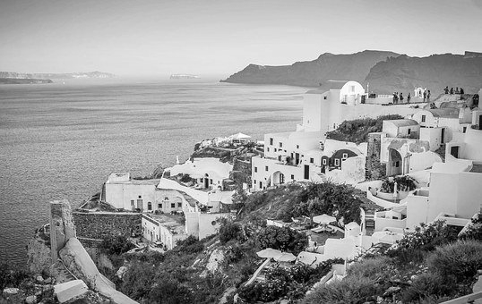
Pictures on a postcard
Postcards usually have a picture of the place you are visiting. When you send a postcard, your family or friends can see what it is like where you are.
Look at family photos of holidays or days out and describe what you can see.
I can see the blue sky.
I can see purple flowers.
Images from Pixabay

Slide 11
Now it’s time to complete the activity
Adding a picture to the postcard
Think about what you have written in your message.
Find images in magazines which link to your holiday or day out.
Cut out and stick the images to the back of your postcard.
You could draw images if you like.

Slide 12
Make it easier
Make it harder
More ideas
Have pictures and symbols available to support the learner to make choices and answer questions.
Scribe for the learner or use pre-written words which can be sequenced.
Reduce the support given to encourage independence.
Remove picture prompts for the learner.
On the next day out, take a photo of your day and use this as inspiration for your next postcard.
Take a walk to the post-box to post your card.

