Slide 1
Recognising the relationship between addition and subtraction
Mathematics Independent Task
Miss Robson

Slide 2
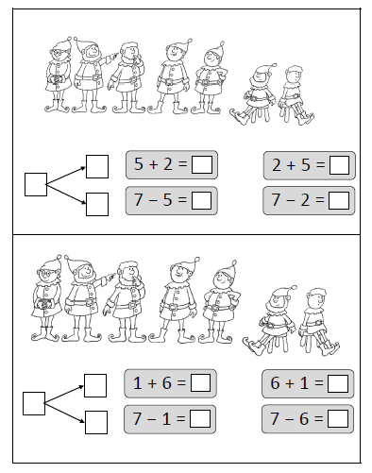
Question 1
Looking at the dwarves who are standing up, and the dwarves that are sitting down, complete the part whole model and related addition and subtraction equations.

Slide 3
Question 2
Looking at the dwarves who are standing up, and the dwarves that are sitting down, complete the part whole model and related addition and subtraction equations.

