Slide 1
Exploring calculation strategies
Adding two 2-digit numbers using the column method
Maths
Mrs Crane

Slide 2
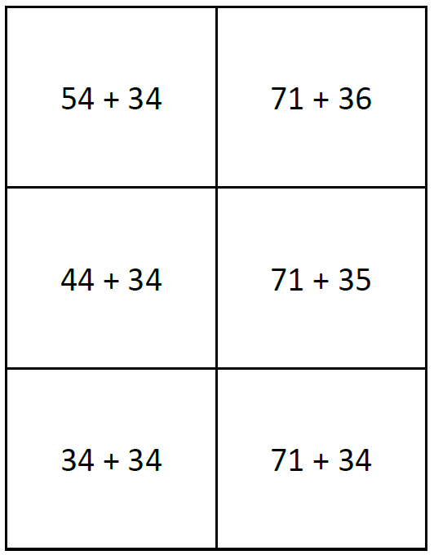
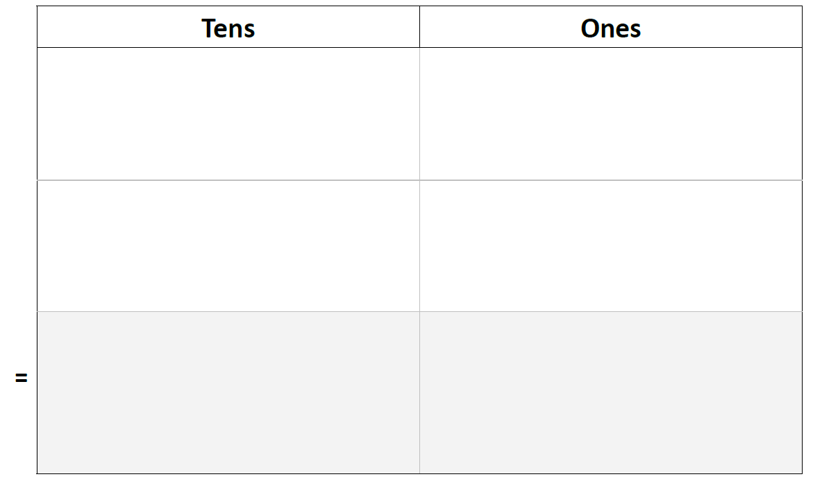
Independent Task
Remember, you can draw out Dienes, use the expanded method or try the column method to solve the equations
Do you notice any patterns in the numbers? Can you explain them?

