Slide 1
Binary – the language of computers
Mathematics
Mr Maseko

Slide 2
Complete the following calculations in base 2.
1 + 1 = 10
10+10 =
100 + 100 =
101 + 101 =
111 + 111 =
1010+1010 =
What do you notice about doubling in base 2?
Write each of the calculations in base 10.
Is it easier to double is base 2 or base 10?

Slide 3
Binary code
A binary code is any code that uses only 2 symbols.
Binary code is very useful in computing.
00100100 00110010 0011100 00100100 00110010 0011100 00100100 00110010 0011100

Slide 4
Computers read binary code in chunks and each chunk codes for a specific symbol.
Each chunk has a certain number of divisions (called bits).
If computer read the code in chunks of 2-bits, how many different binary codes can you make?

Slide 5
A computer reads code in chunks of 3-bits. Show all the different binary codes the computer can read. One has been done for you.
000
A computer reads code in chunks of 4-bits. Show all the different binary codes the computer can read. One has already been done for you.
0000
What do you notice about the number of codes and the size of the chunks? What similarity does the number of codes possible have with the base 2 place value chart?

Slide 6
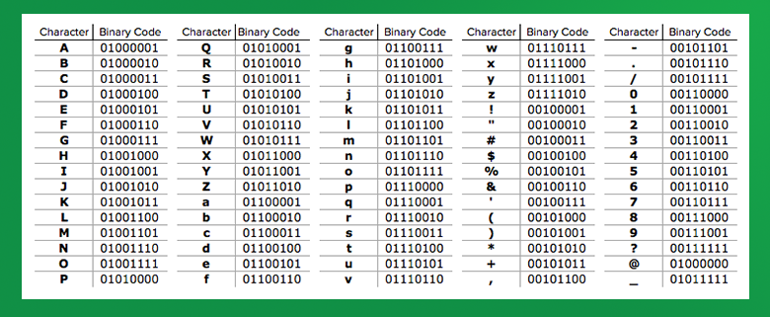
Reading binary code
Source: Science Friday
Use the binary code table to write your name in binary code. Leave a space after each 8-bit chunk.

