Slide 1
Grouping and sharing
Exploring counting in groups of two to find the total
Mathematics Independent Task
Mrs Khaira

Slide 2
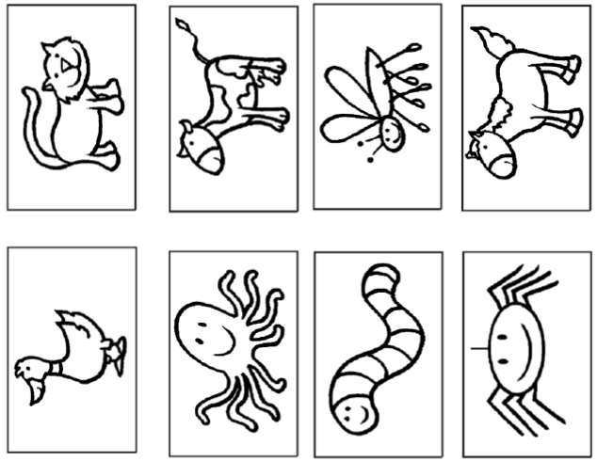
Activity 1

Slide 3
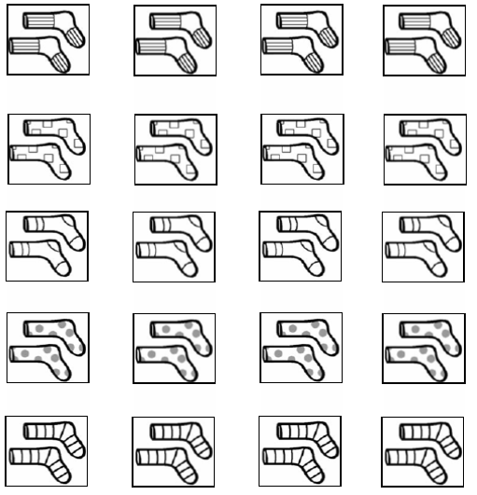
Activity 2

