Slide 1
Ask about what others have done at a specific time vs in general (Part 2/2)
Irregular past participles (with avoir)
Asking questions in the past tense (est-ce que & qu’est-ce que)
Downloadable Resource
French
Madame Johnson

Slide 2
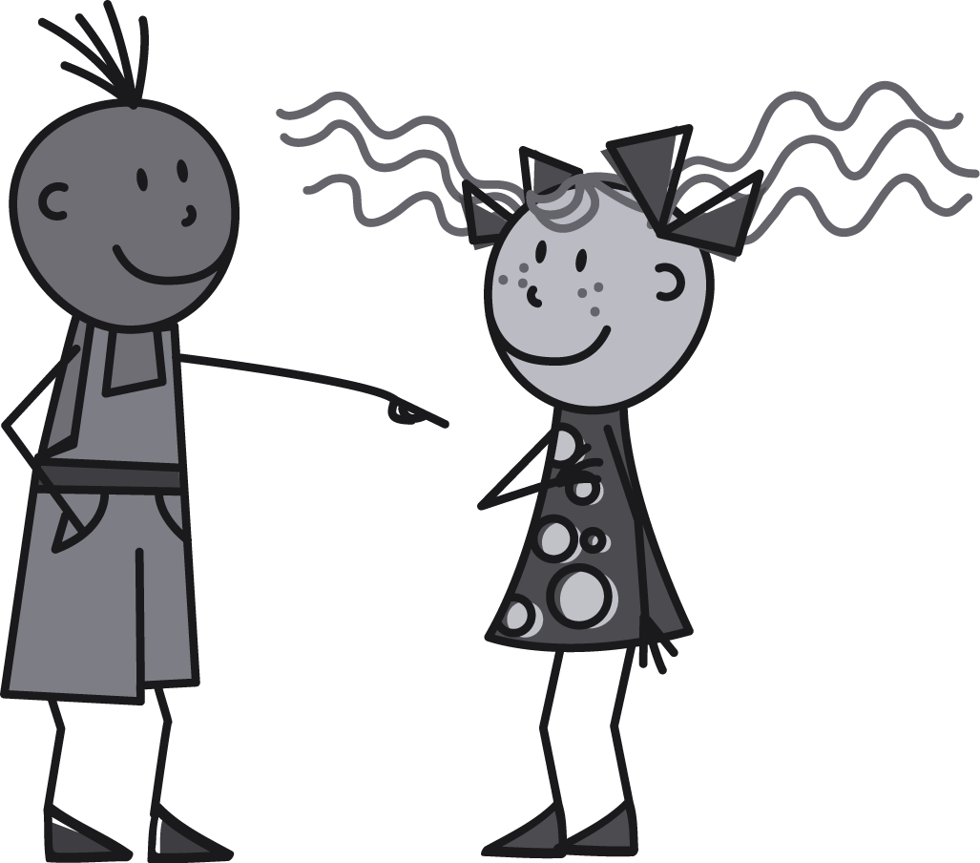
[ u ]
tu

Slide 3
[ u ]
amusant
utiliser
[to use]
sur
[on]

Slide 4
Vocabulary list for this lesson:
la route | road
la leçon | lesson
bu (boire) | drank (to drink)
eu (avoir) | had (to have)
appris (apprendre) | learnt (to learn)
compris (comprendre) | understood (to understand)
pris (prendre) | taken (to take)
la faim | hunger
la peur | fear
ensuite | next, then
Avoir faim = to be hungry
Avoir peur = to be scared

Slide 5
1. The Subject Pronoun
2. The Auxiliary Verb
(Avoir - Present Tense)
3. Past Participle
Je | ai
Tu | as
Il / Elle | a
Nous | avons
Vous | avez
Ils / Elles | ont
Sometimes the past participle is irregular!
boire - bu
avoir - eu
apprendre - appris
comprendre - compris
prendre - pris

Slide 6
Noticing similar patterns
J’ai bu
J’ai eu
boire
avoir
I drank
I had

Slide 7
Noticing similar patterns
J’ai appris
J’ai compris
J’ai pris
prendre
apprendre
comprendre
I took
I learnt
I understood

Slide 8
For more on forming questions with ‘est-ce que’ and ‘qu’est-ce que’ please see lessons:
Compare past experiences
(Parts 1 & 2) - Unit 5, lessons 3 & 4
Talk about what you and others did and did not do
(Parts 1 & 2) - Unit 5, lessons 5 & 6

Slide 9
Yes / No Question
Question with intonation
Est-ce que question
Tu as appris l’anglais?
Est-ce que tu as appris l’anglais?
Est-ce que
pronoun
auxiliary
Past participle
Est-ce que tu as appris _____?
Est-ce que changes to est-ce qu’ before a vowel.
Est-ce qu’il a appris _____?

Slide 10
Information question
Qu’est-ce que question
past participle
Que
est-ce que
pronoun
auxiliary
= qu’est-ce que
Qu’est-ce que tu as regardé?
What did you watch?

Slide 11
as
est-ce que
tu
Qu’
bu?
Qu’
est-ce que
tu
as
bu?
What did you drink?
Information question

Slide 12
Ask about what others have done at a specific time vs in general (Part 2/2)
1 | What did you learn? =
2 | Did he understand? =
3 | What did she drink? =
4 | Did he take the plane? =
Qu’est-ce que tu as appris?
Est-ce qu’il a compris?
Qu’est-ce qu’elle a bu?
Est-ce qu’il a pris l’avion?

