Slide 1
Lesson 2: Introduction to the CPU
Computer systems
Computing
Mac Bowley
Materials from the Teach Computing Curriculum created by the National Centre for Computing Education

Slide 2
Von Neumann architecture - fill in the blanks
(each word is only used once)
Von Neumann architecture describes the _____ of a computer system. In the Von Neumann model both _____ and ______ are stored in memory as ______.
Instructions are ______ from memory one by one, the processor will _______ the instruction before executing it.
fetched
design
data
decode
instructions
binary

Slide 3
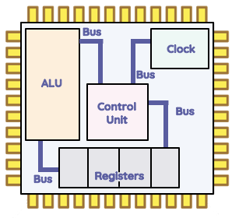
The CPU team - Part 1
The ALU
Clock
Buses
Control Unit
Registers

Slide 4
The CPU team - Part 2
Component | Stores | Manages | Controls
Control Unit
Arithmetic Logic Unit
Registers
Buses
Clock

Slide 5
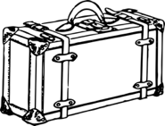
Remembering the components
For each of the components of the CPU, choose a memorable image to represent it and sketch it in your notes. Justify why the image is suitable next to it. You can use these for inspiration, but it is better if you make them up for yourself.
Credit: Pixabay
Credit: Pixabay
Credit: Pixabay
Credit: Pixabay

