Slide 1
Shopping for food
Talking about quantities using de
French
Mademoiselle Martin

Slide 2
Phonétique

Slide 3
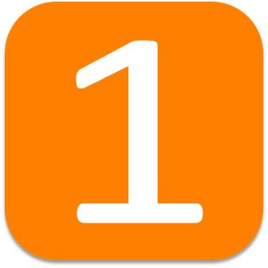
[ un ]
un

Slide 4
[ un ]
quelqu’un
lundi

Slide 5
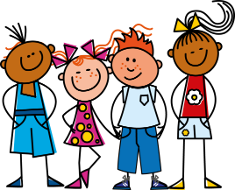
[ ou ]
nous

Slide 6
[ ou ]
trouver
toujours
jouer
[always; still]

Slide 7
Vocabulaire

Slide 8
une bouteille | a bottle
une tranche | a slice
une boîte | a tin
un pot | a jar
un morceau | a piece
le marché | market
la poissonnerie | fish shop
la boulangerie | bakery
la boucherie | butcher’s
l’épicerie | grocery shop, local shop

Slide 9
Grammaire Talking about quantities using de

Slide 10
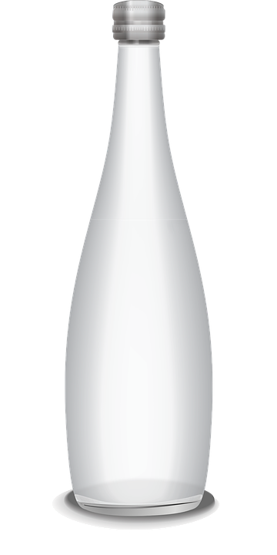
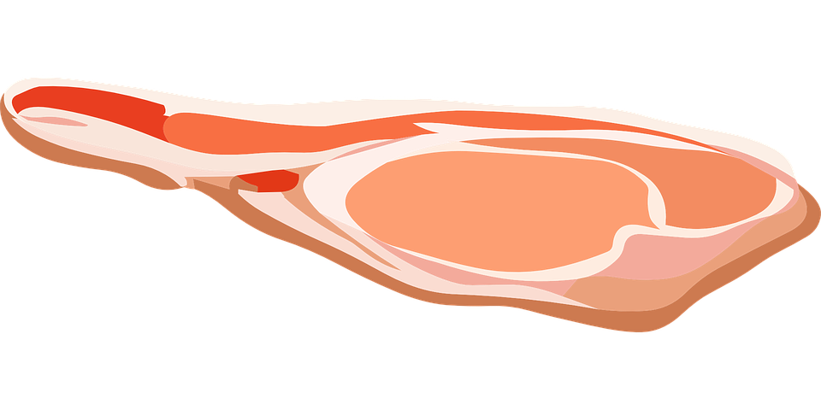
Using quantities with de
Expressions of quantity are always followed by de or d’ (if the noun starts with a vowel or silent -h)
une tranche de bacon
une bouteille de lait
= a slice of bacon
= a bottle of milk

Slide 11
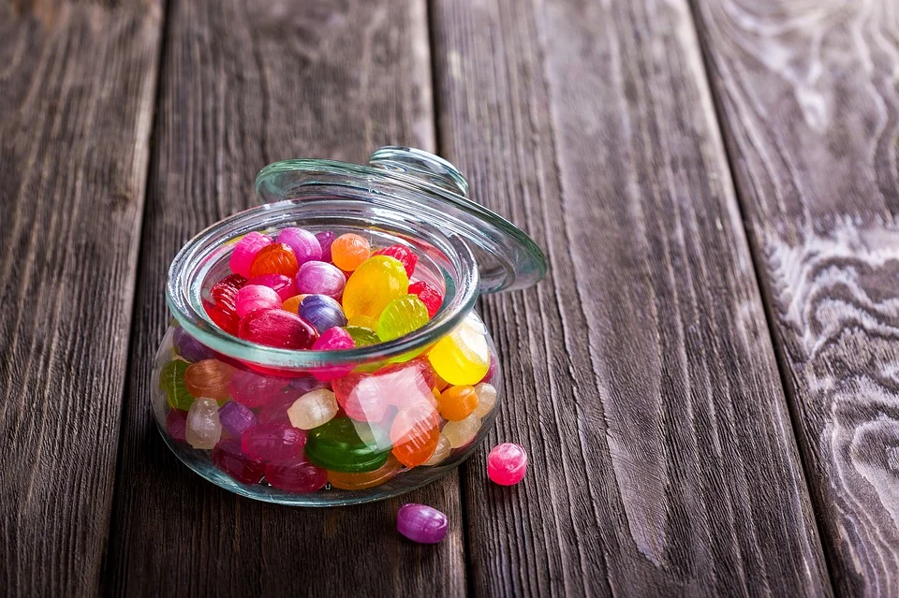
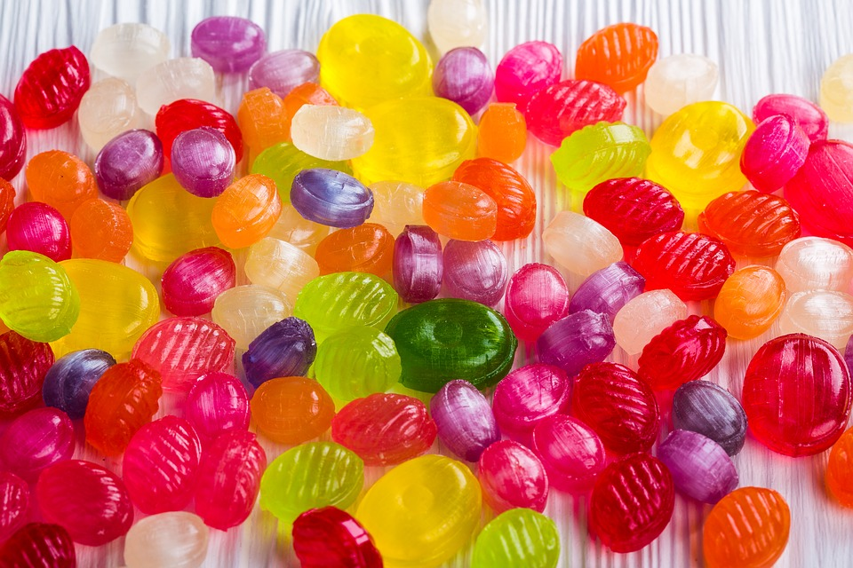
Using quantities with de
Adverbs of quantity are always followed by de or d’ (if the noun starts with a vowel or silent -h)
J’ai assez de bonbons
J’ai beaucoup de bonbons
= I have enough (of) sweets
= I have lots of sweets

Slide 12
Using quantities with de
When talking about quantities, they are always followed by de or d’ (if the noun starts with a vowel or silent -h)
une tranche de
beaucoup de
= a slice of
= lots of

Slide 13
Using quantities with de
Quantities are always followed by de or d’ (if the noun starts with a vowel or silent -h). For example:
une tranche de jambon
= a slice of ham
une bouteille de champagne
= a bottle of champagne
une boîte de bonbons
= a tin of sweets
un pot de miel
= a pot of honey
un morceau de pain
= a piece of bread
beaucoup de chocolat
= lots of chocolate
trop de fromage
= too much cheese

Slide 14
Shopping for food
Expressions of quantity are always followed by ...
2. I would like =
3. A piece of =
4. A slice of =
5. Lots of chocolate =
de or d’ (if followed by a vowel)
5
4
Je voudrais
3
un morceau de
2
1
une tranche de
beaucoup de chocolat

